Slide 1

Development of a supervised machine learning tool to infer active regulatory elements from transcription initiation events
Student: Stefano Pellegrini
Supervisors: Robin Andersson, Marco Salvatore
Bioinformatics Centre,
Copenhagen, July 12

Slide 2
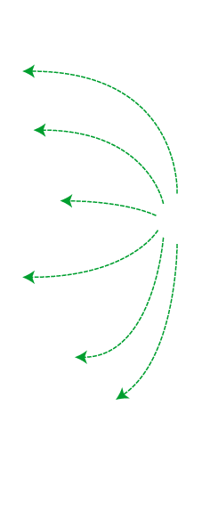
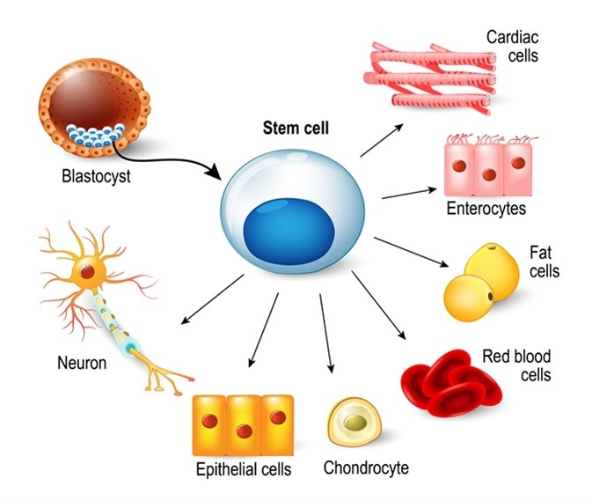
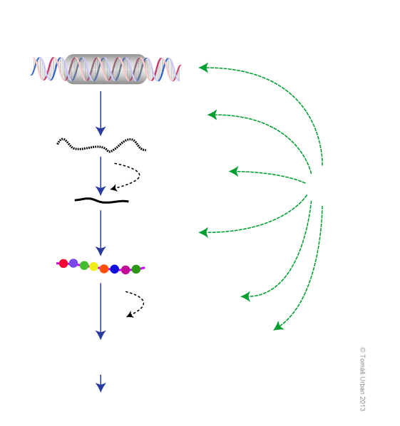

Gene regulation
Spatiotemporal control of biological processes
Gene expression
DNA
Chromatin accessibility
Transcription
mRNA
Post-transcription
modification
Processed
mRNA
Levels of control
RNA stability
Translation
a.a. chain
Post-translation modification
Protein

Slide 3
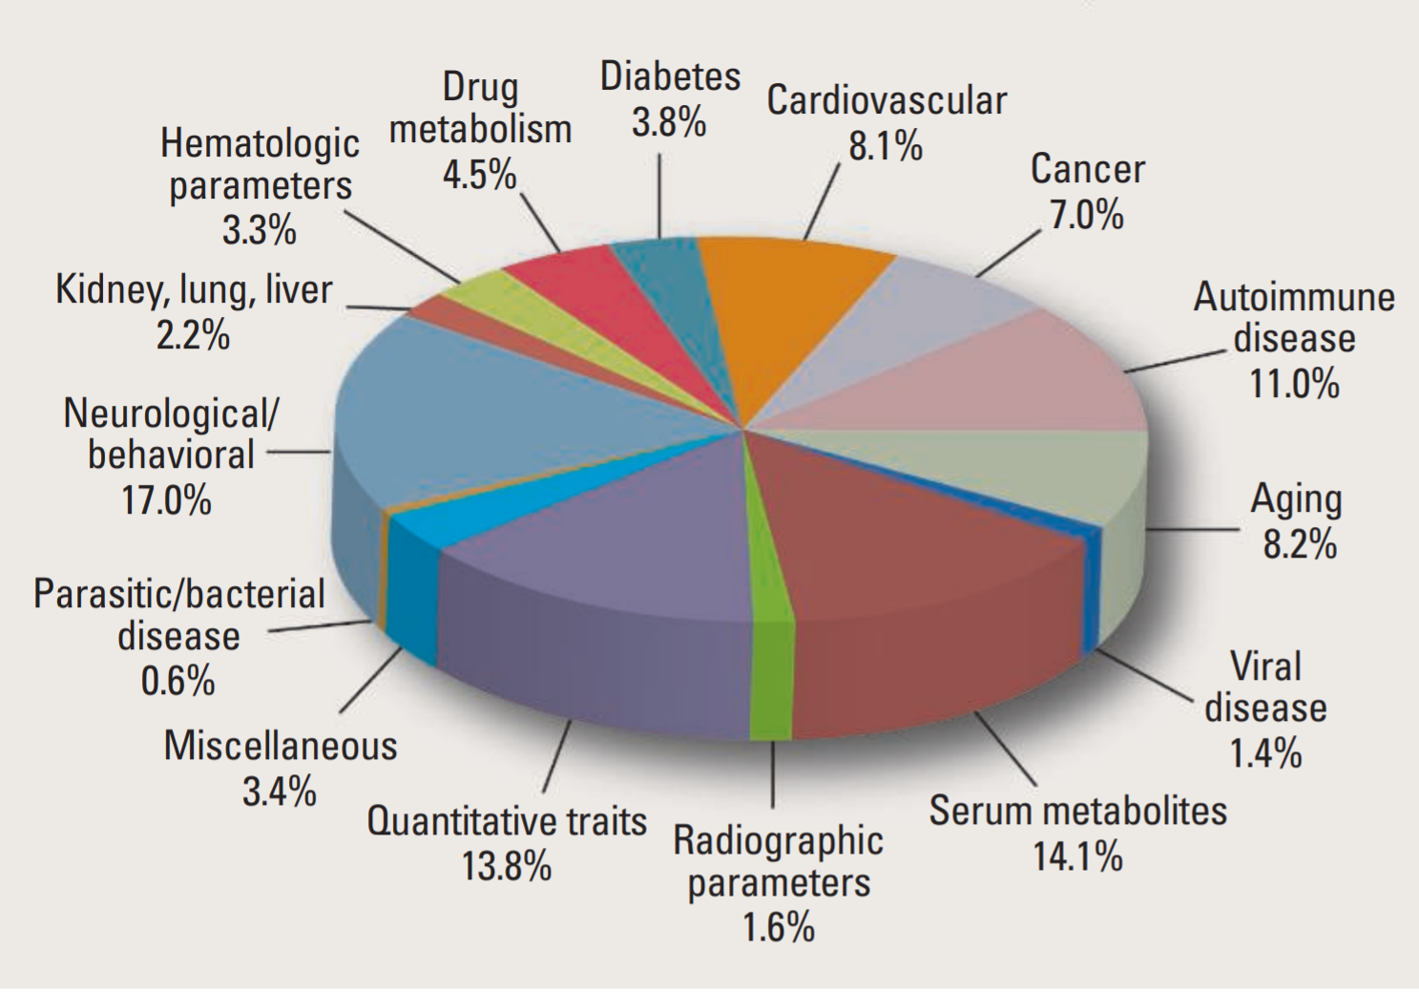
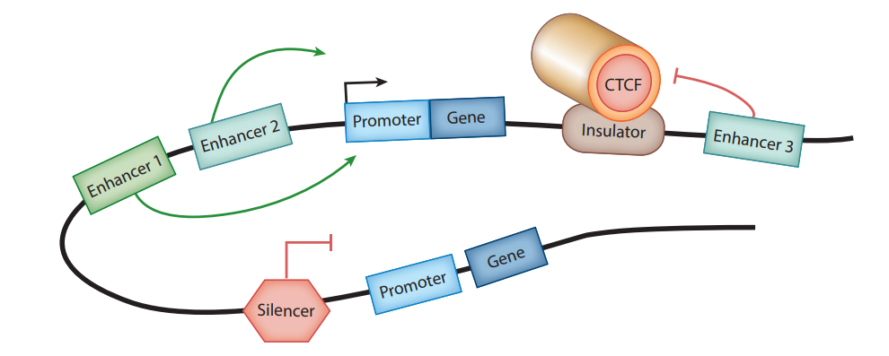
Transcriptional regulatory elements (TREs)
TREs
SNPs in regulatory sites are linked to diseases
Chatterjee, Sumantra, and Nadav Ahituv, 2017
Stamatoyannopoulos, et al, 2012

Slide 4
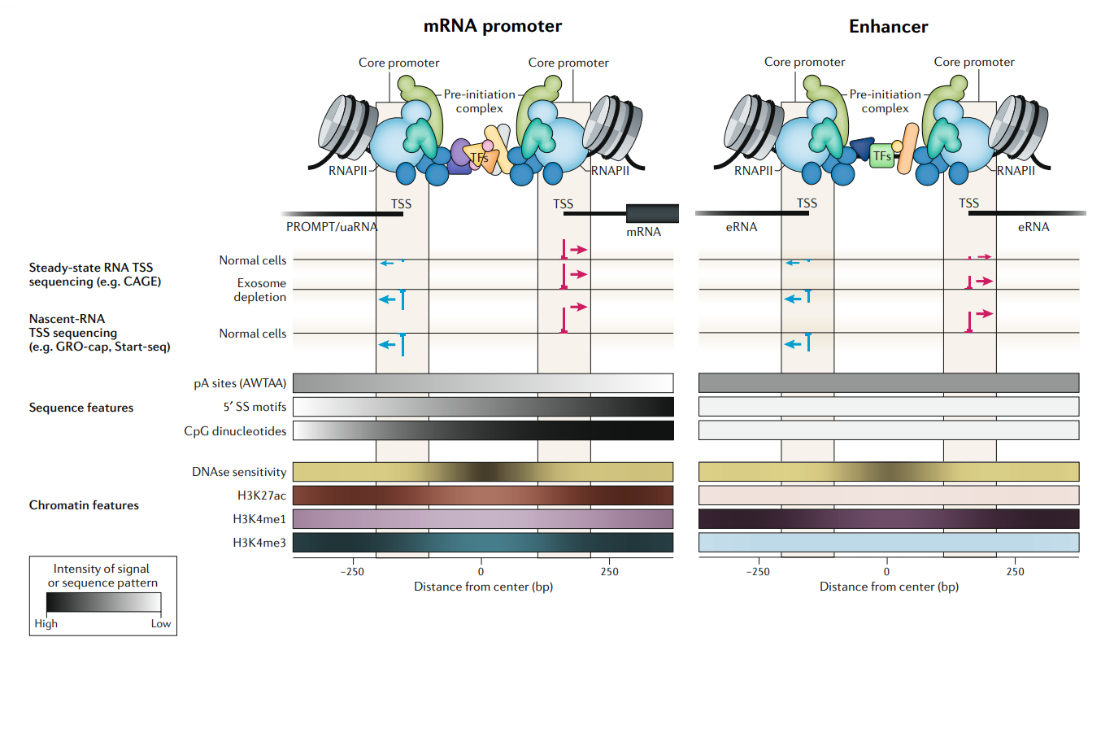
Similar promoter architecture
Robin Andersson and Albin Sandelin, 2020

Slide 5
Method general overview
Tool input and output
New TSS profiling data
Genome-wide prediction of active TREs
Binary classification
Positive samples
Transcriptional active OCRs
Negative samples
Transcriptional active regions in closed chromatin state
Method development
ATAC-Seq or DNase-seq
&
CAGE
Input extraction
Model training and evaluation
(GBDT and CNN)

Slide 6
Training, validation and test sets
Training (CV)
Validation (CV)
ATAC-Seq
&
CAGE
(6 timepoints +TNF α)
TPs 0 to 2
TP 6
Chr 1, 5 to 22, X, Y
Chr 2, 3, 4
GM12878
Test-1
Test-2
DNase-Seq
&
CAGE
(6 timepoints +TNF α)
GM12878
TP 6
Chr 2, 3, 4
DNase-Seq
&
CAGE
(Rrp40 KO and control)
Control
Rrp40 KO
Test-3
Test-4
HeLa

Slide 7
ATAC-Seq or DNase-Seq data
Input extraction pipeline
Detection of open chromatin regions
GM12878 or HeLa
ATAC/DNase positive regions
(peaks extended both side)
ATAC/DNase negative regions
(shuffled from the genome)
Data augmentation
Data augmentation
CAGE profiles extraction
CAGE data
Positive set
Negative set
Remove intra-overlaps
(rank approach)
Minimum requirement of transcription
(CTSS score of 2)
Final positive set
Final negative set

Slide 8
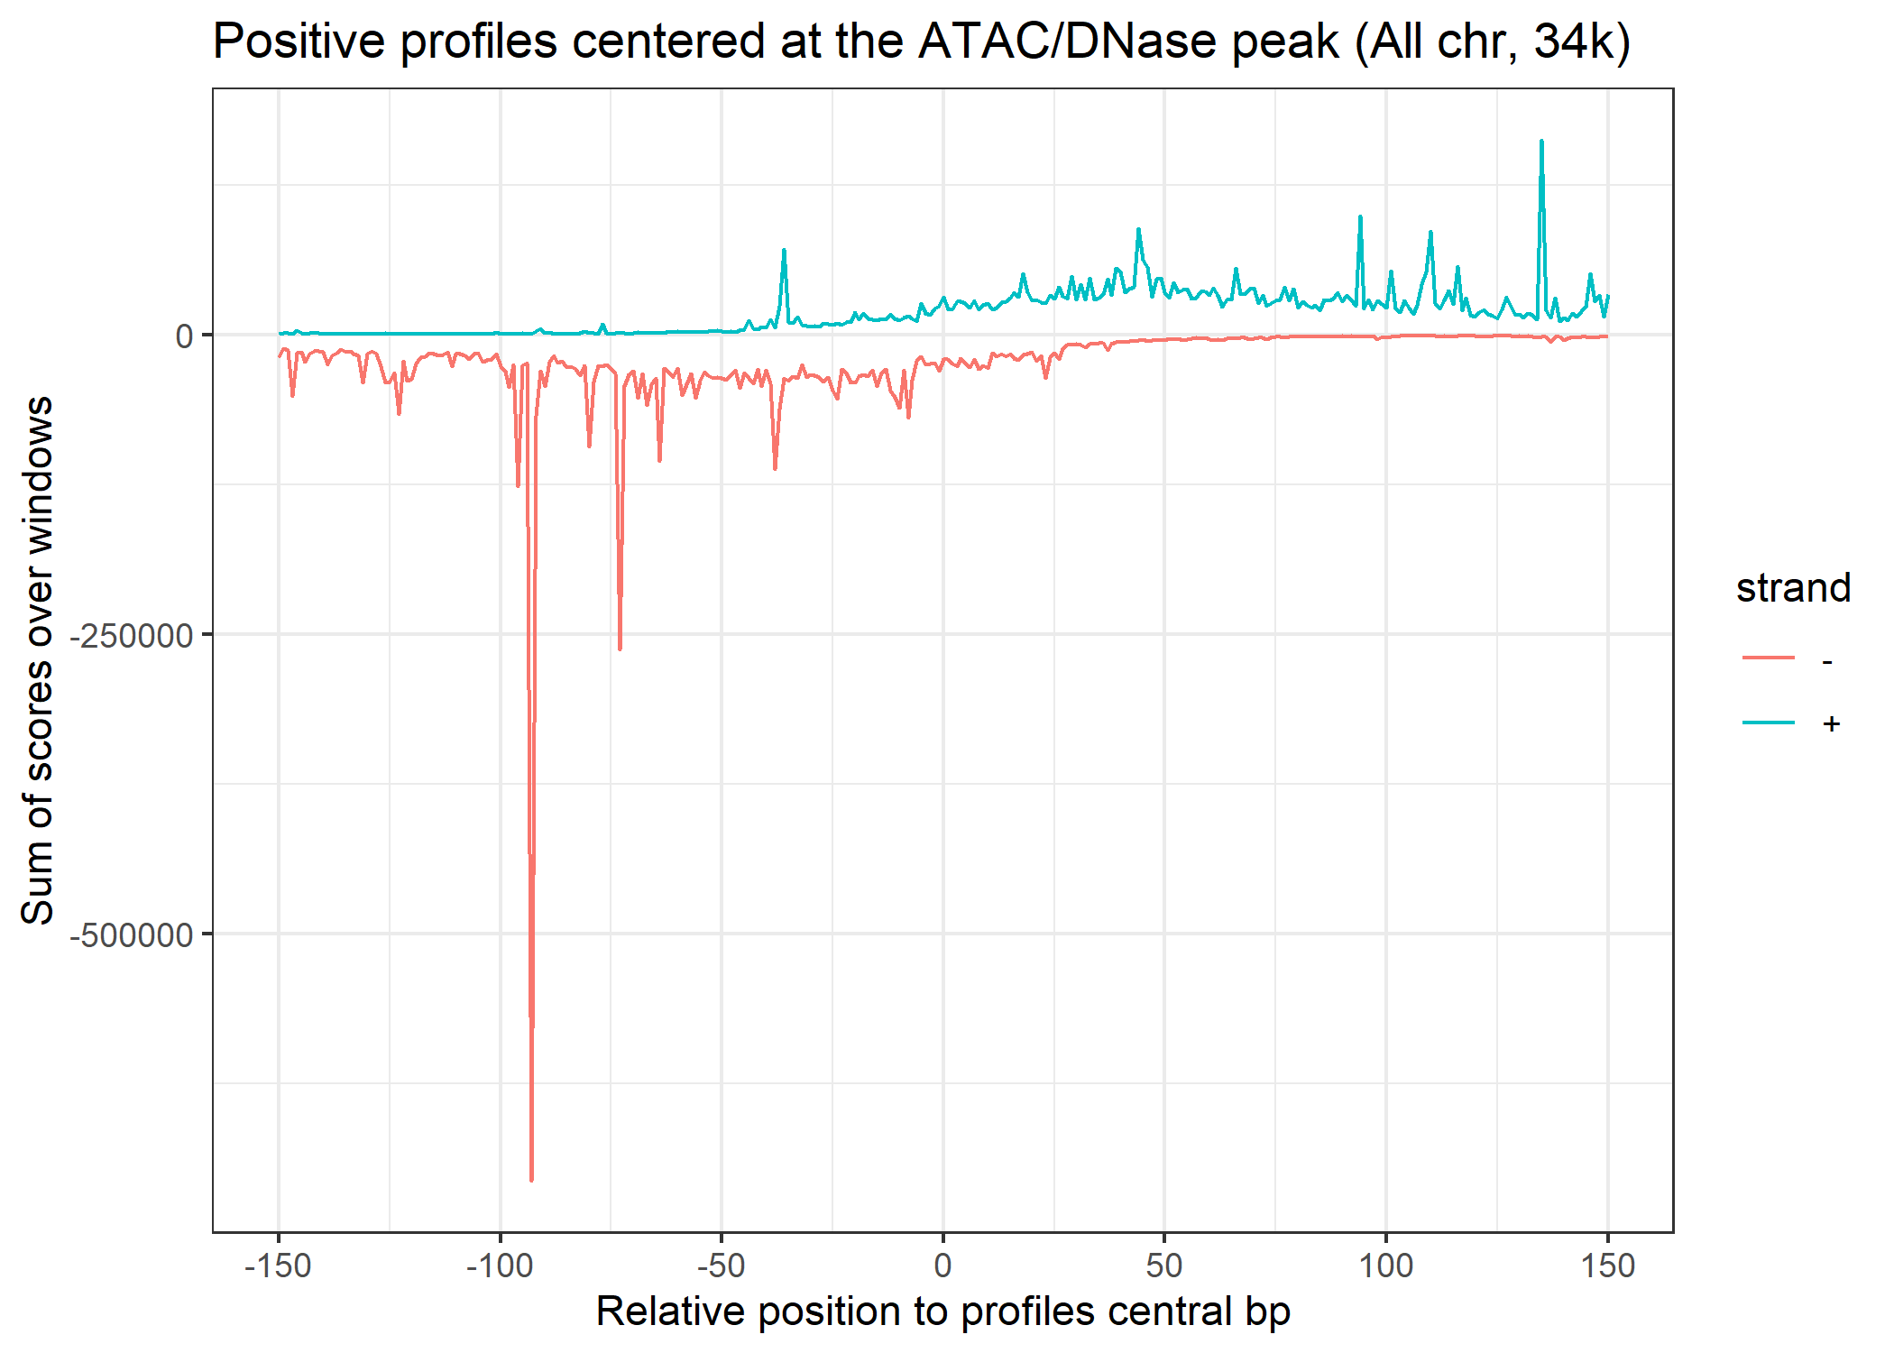
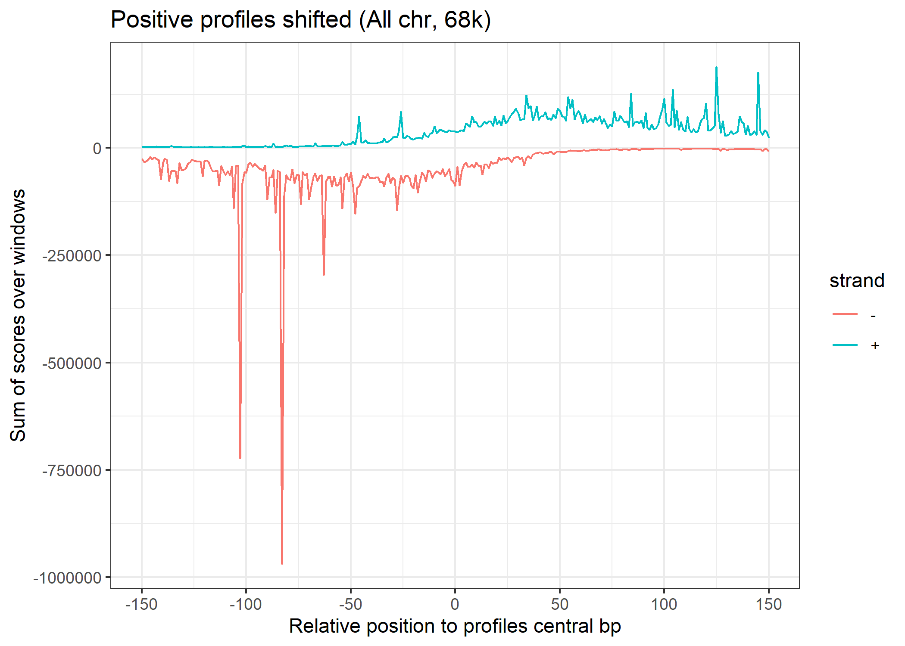
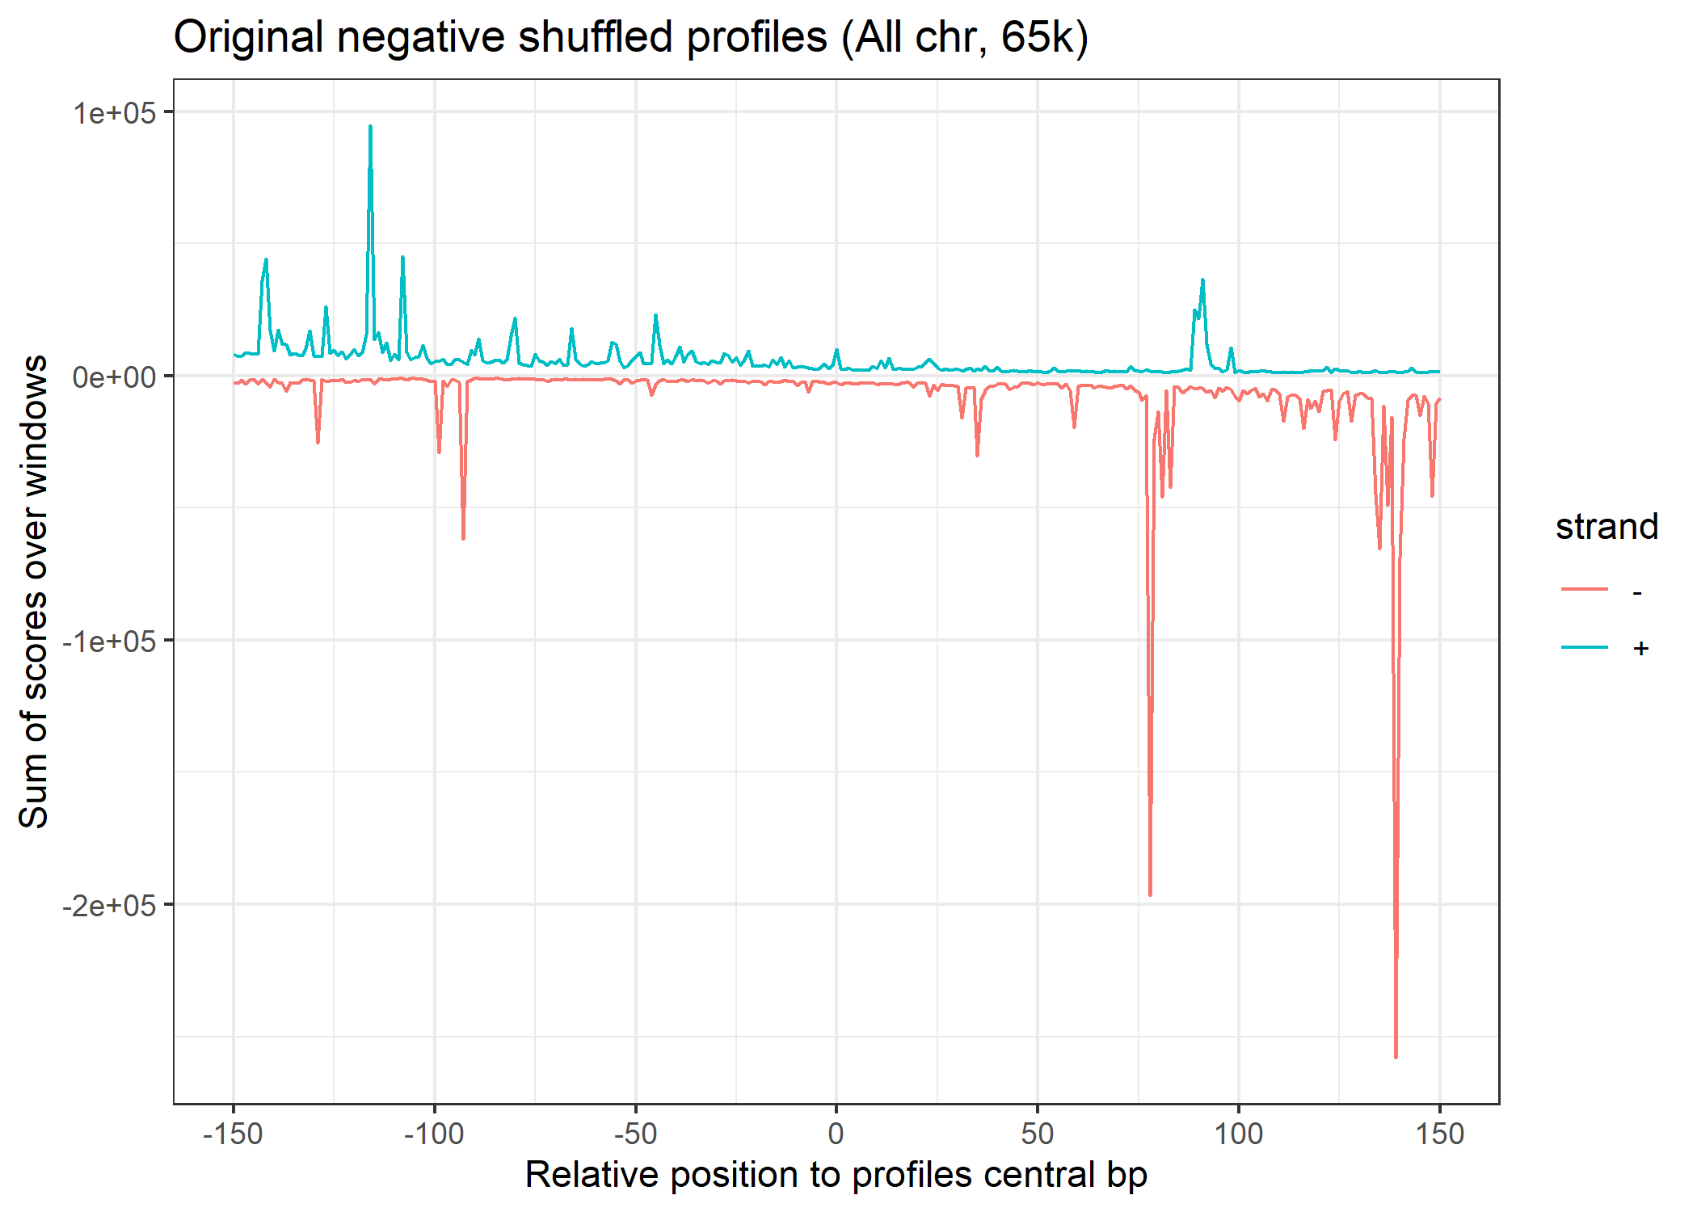
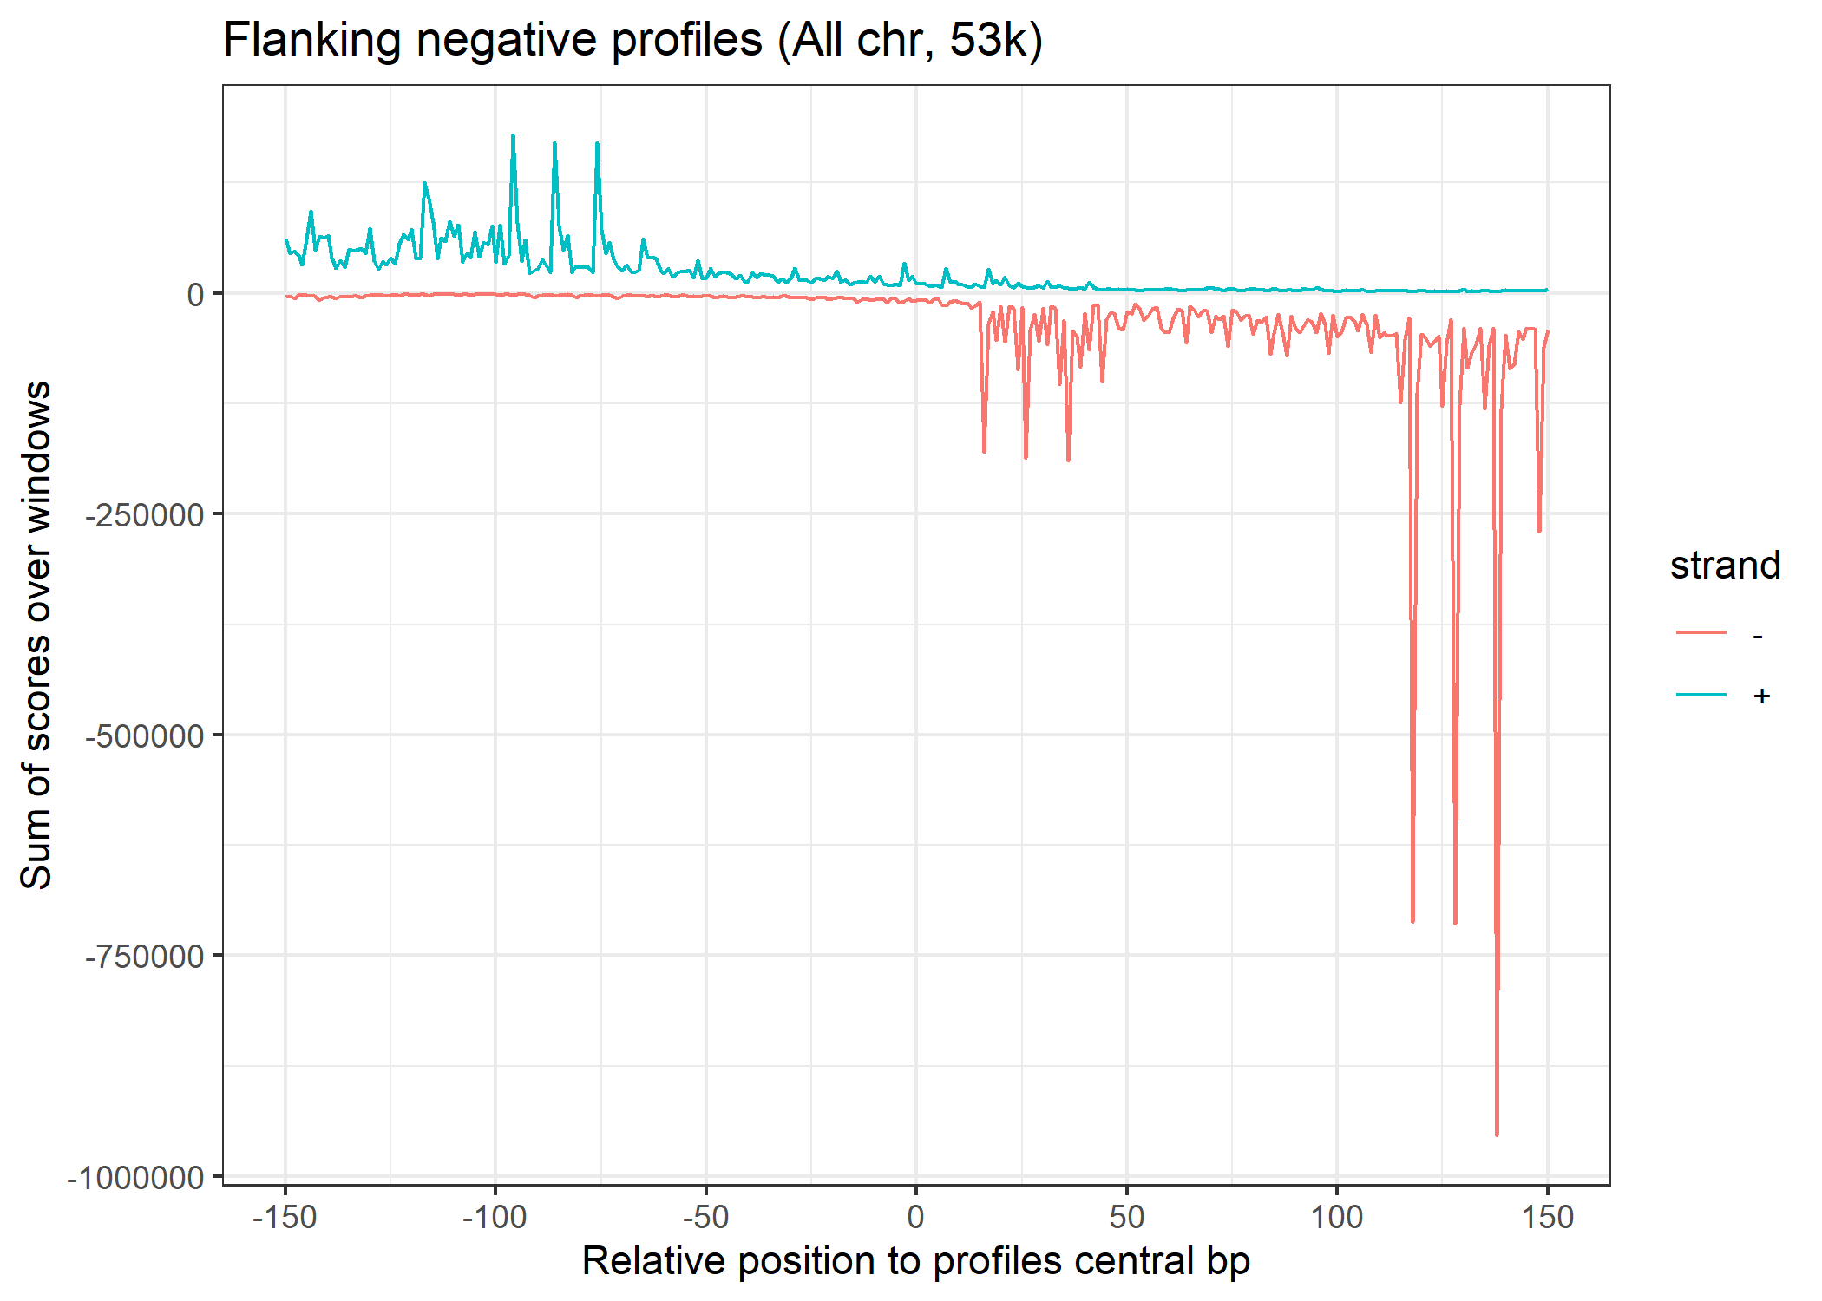
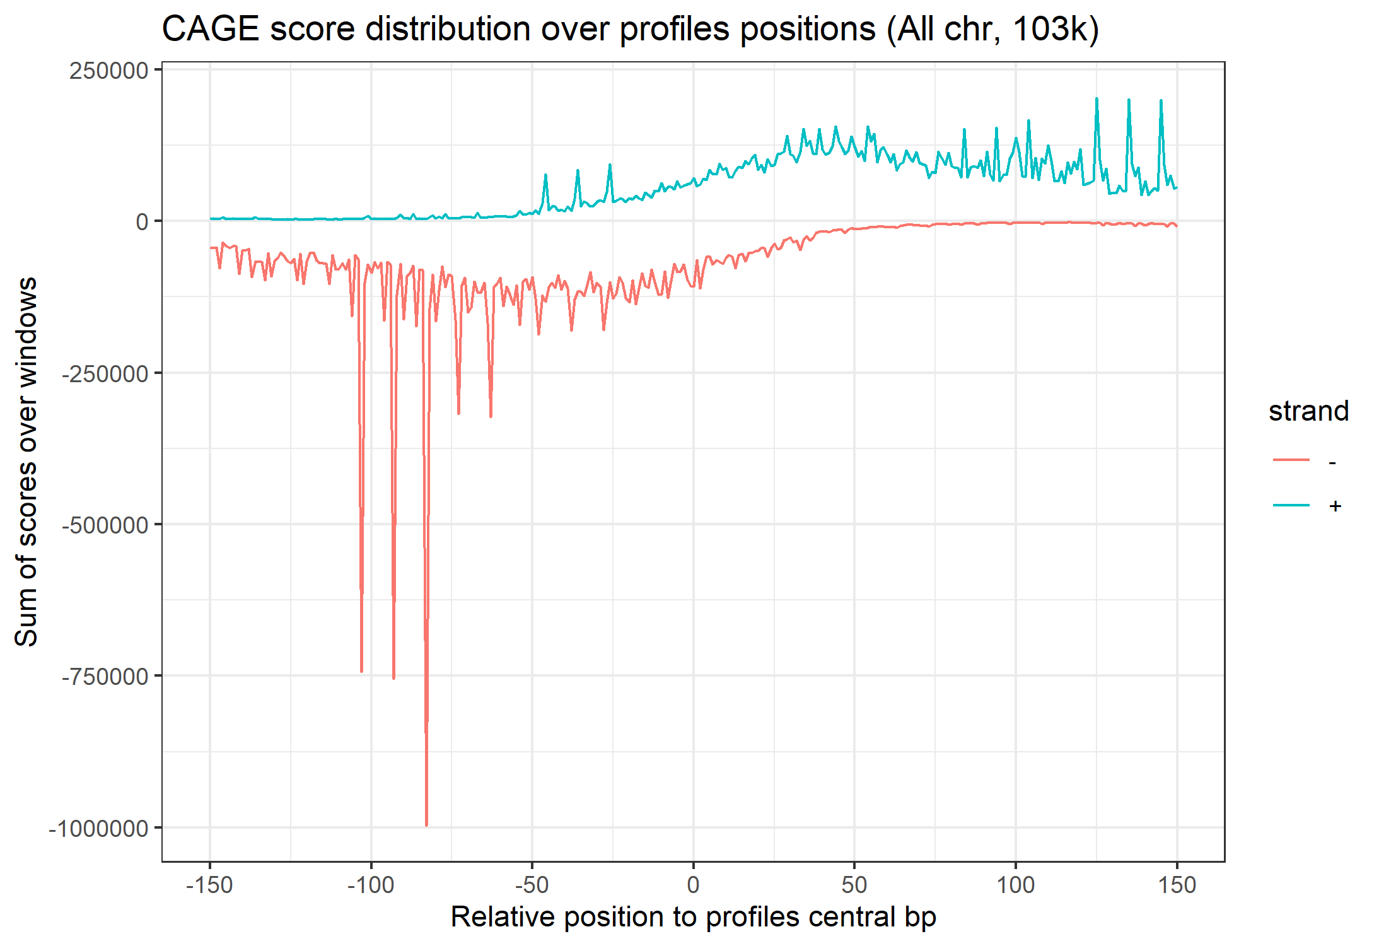
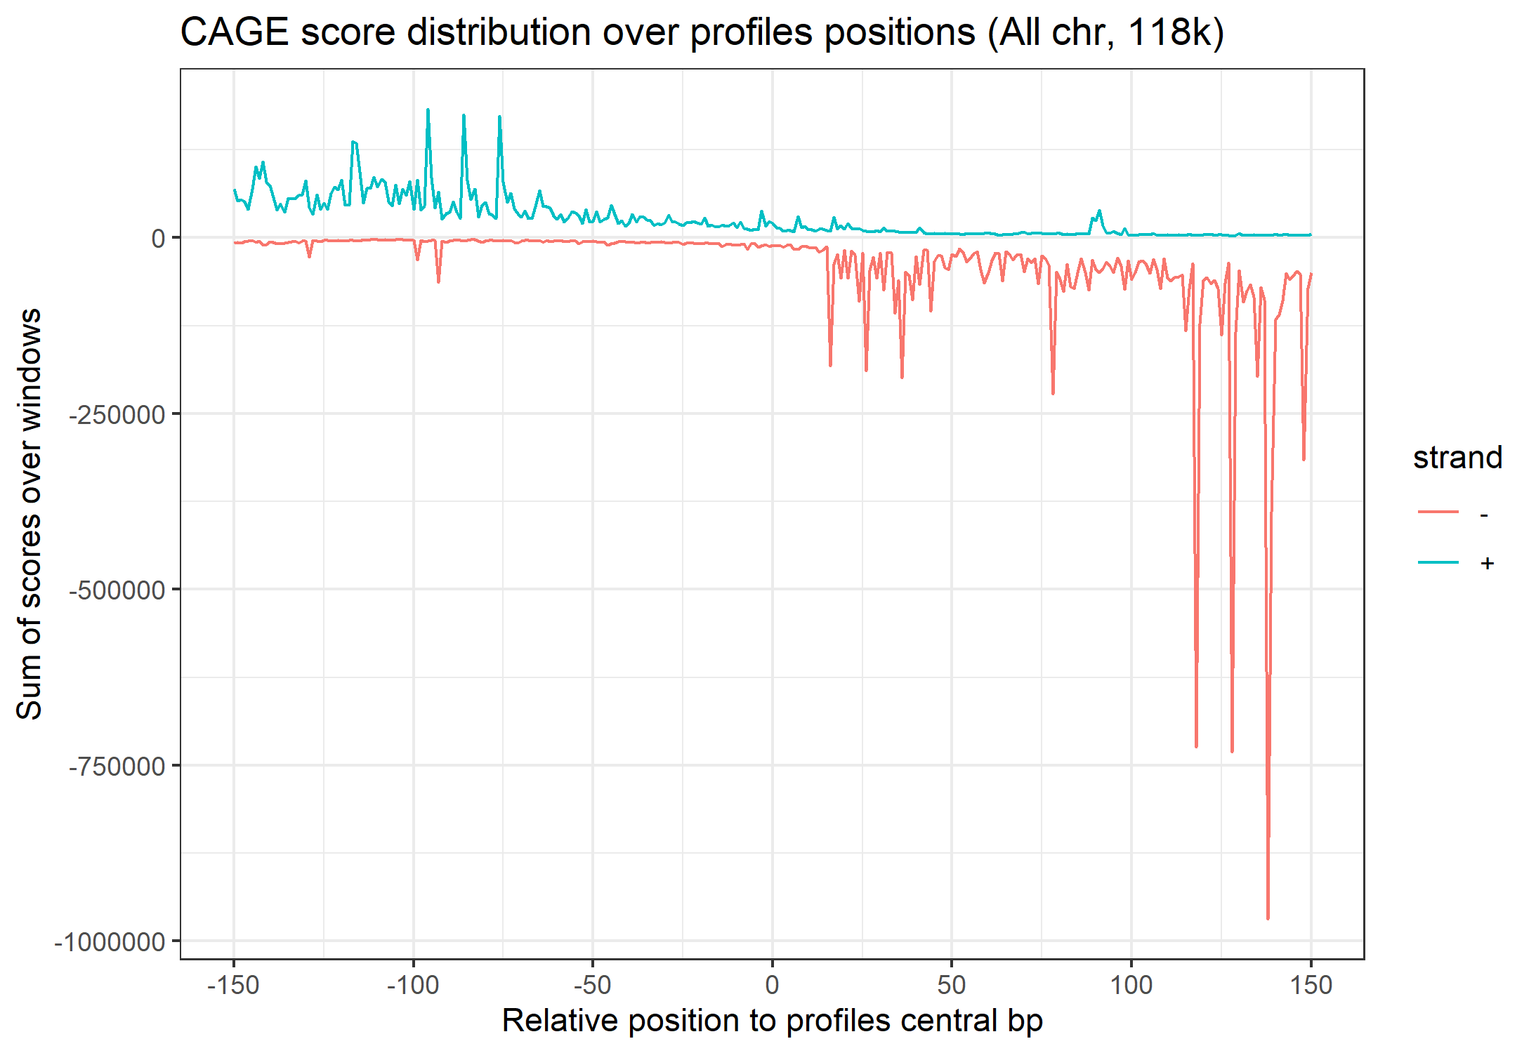
Training set extraction
Positive profile R1
Negative profile R1
Positives
Positives shifted
Negatives
Negatives flanking shifted
Positives augmented
Negatives augmented

Slide 9
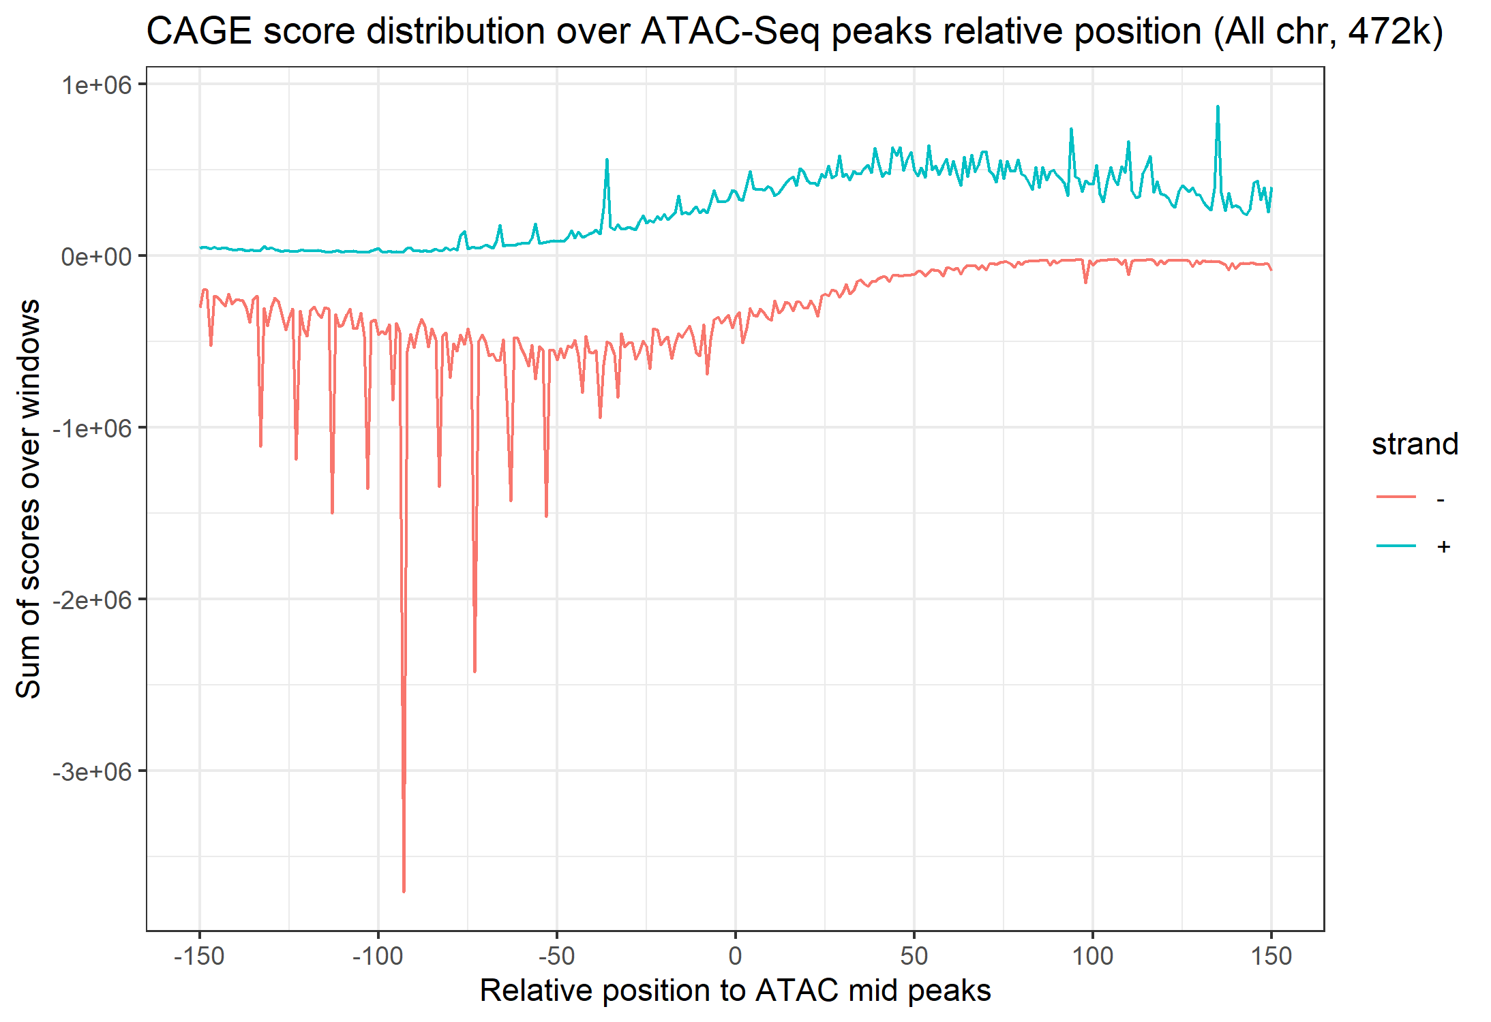
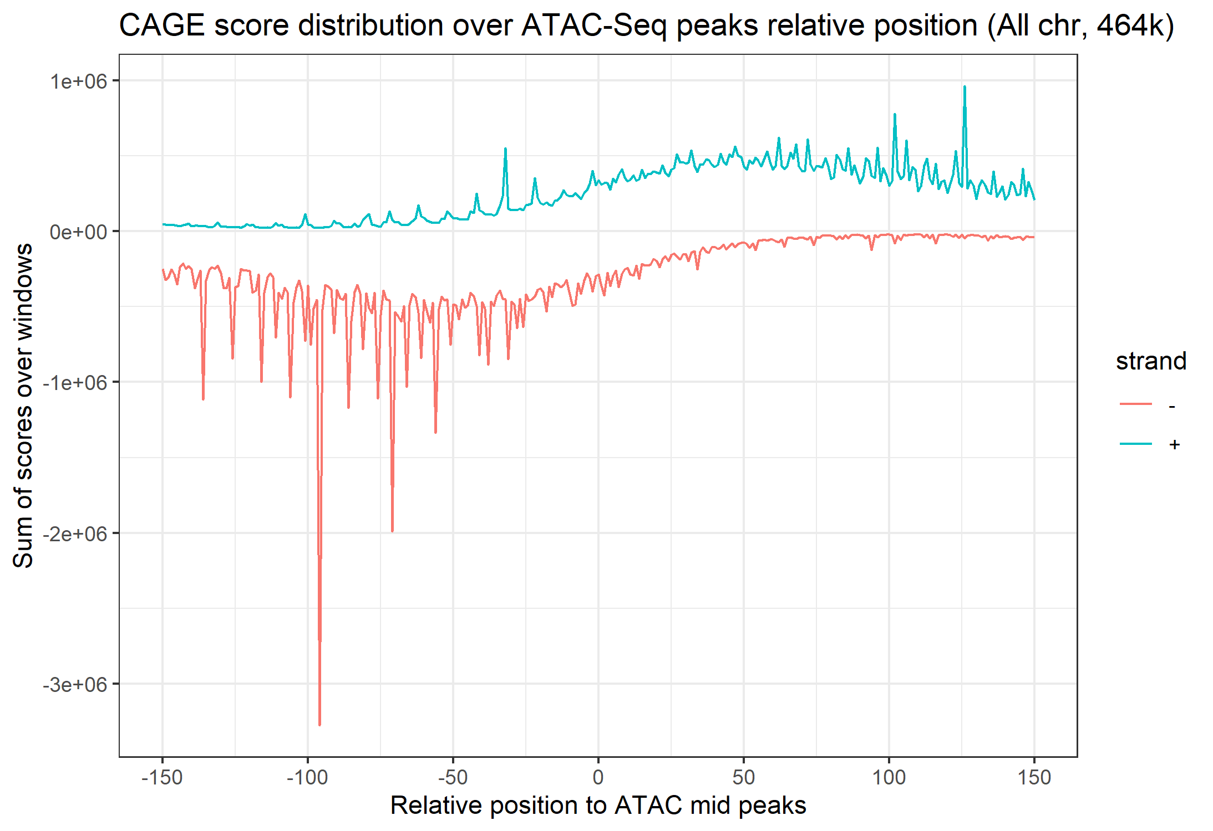

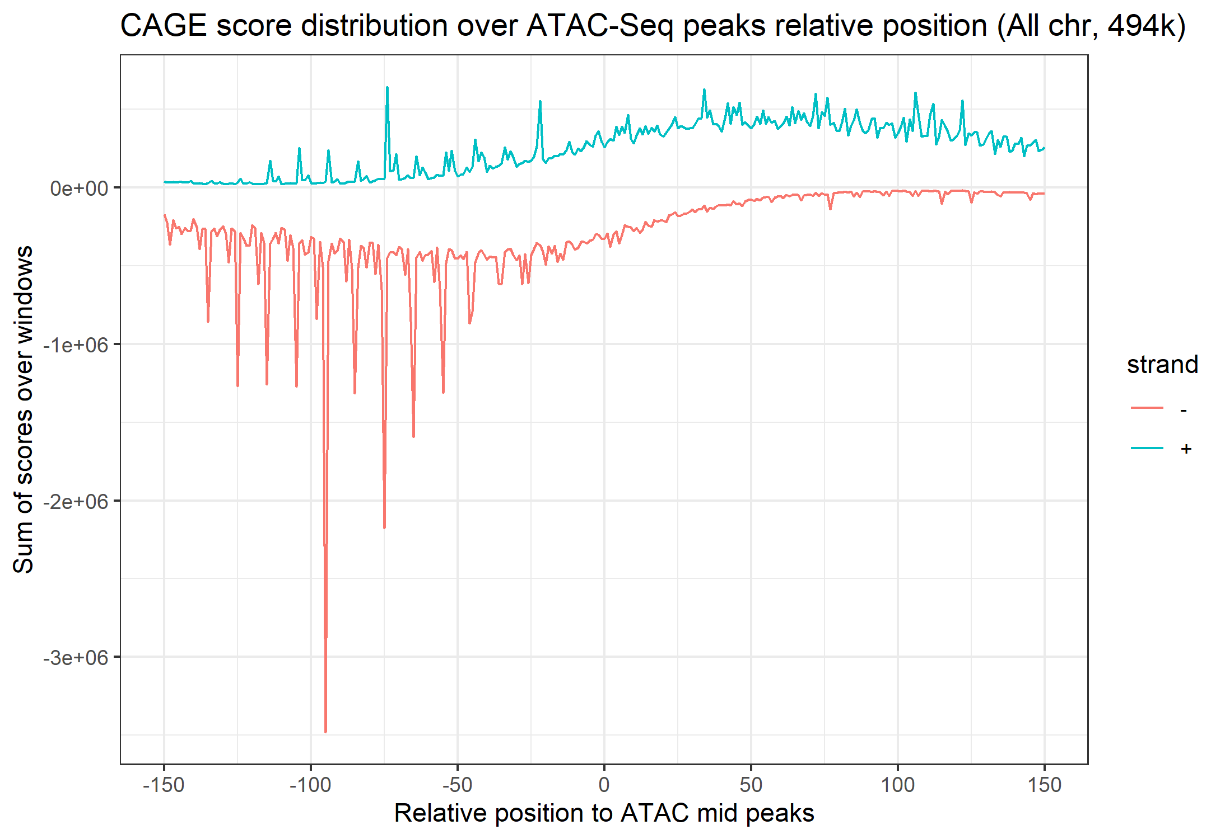

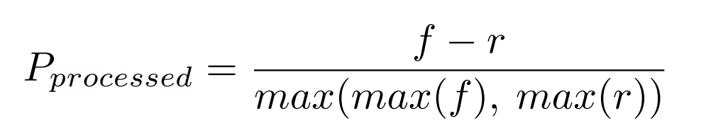
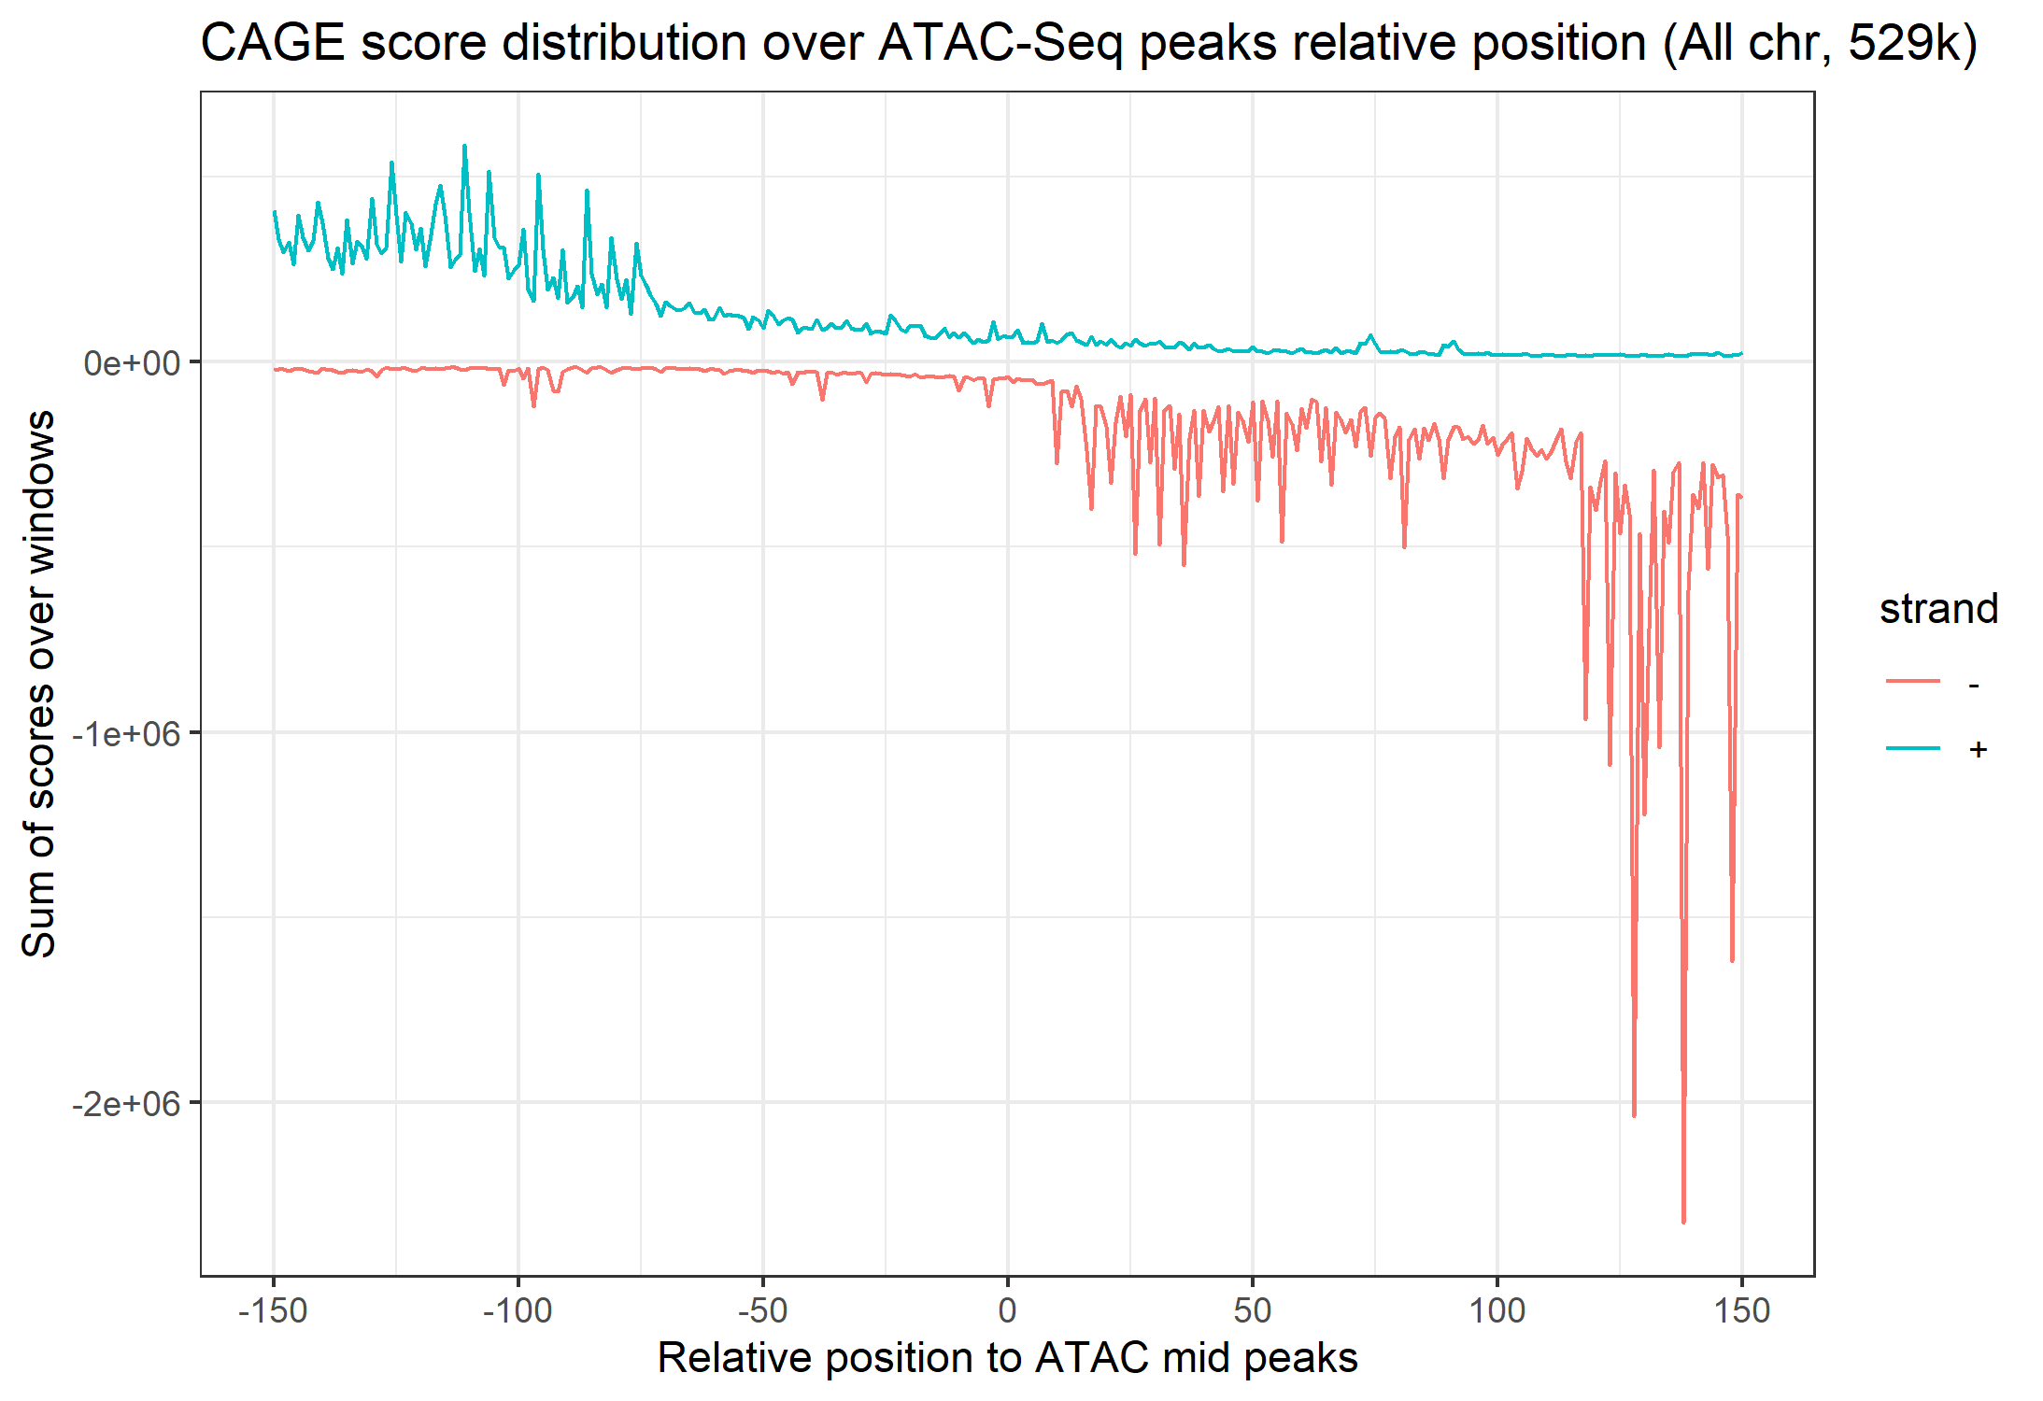
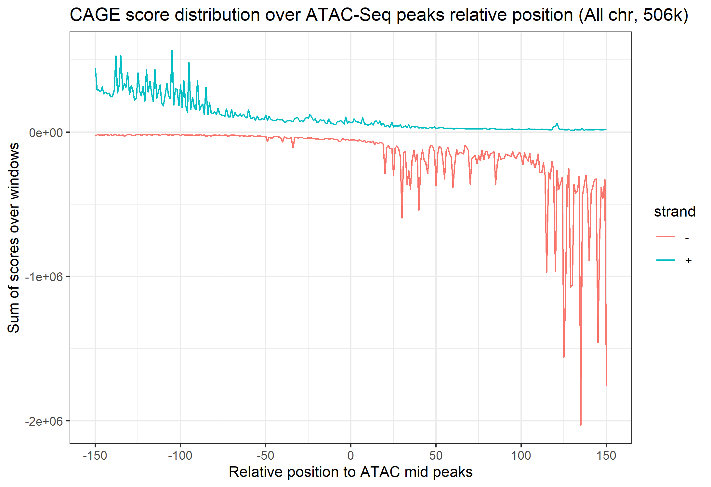
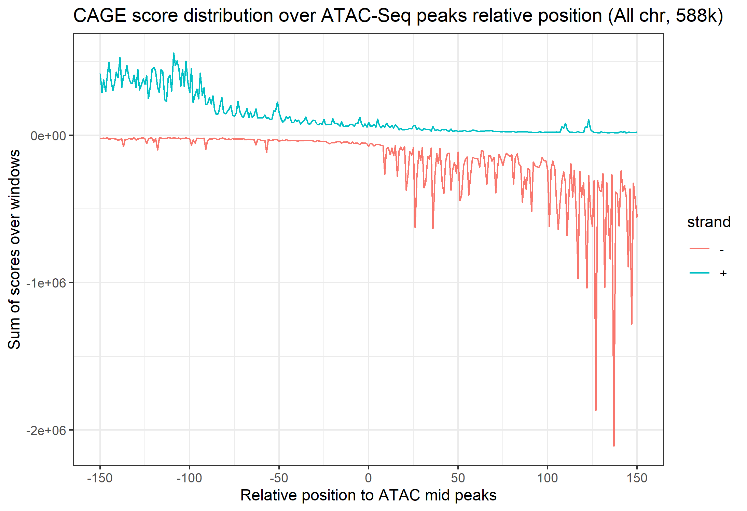
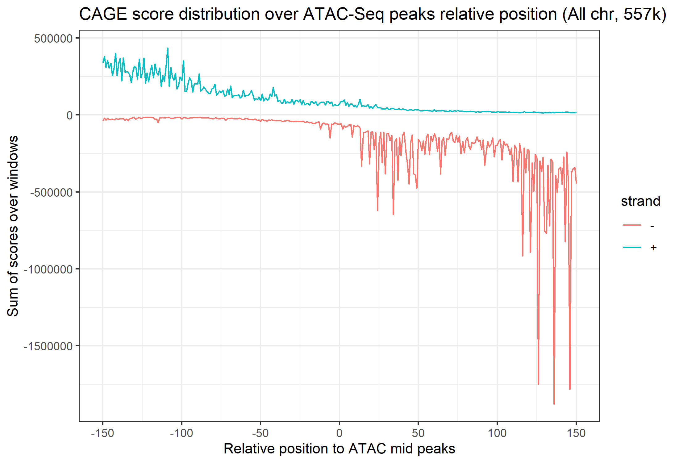
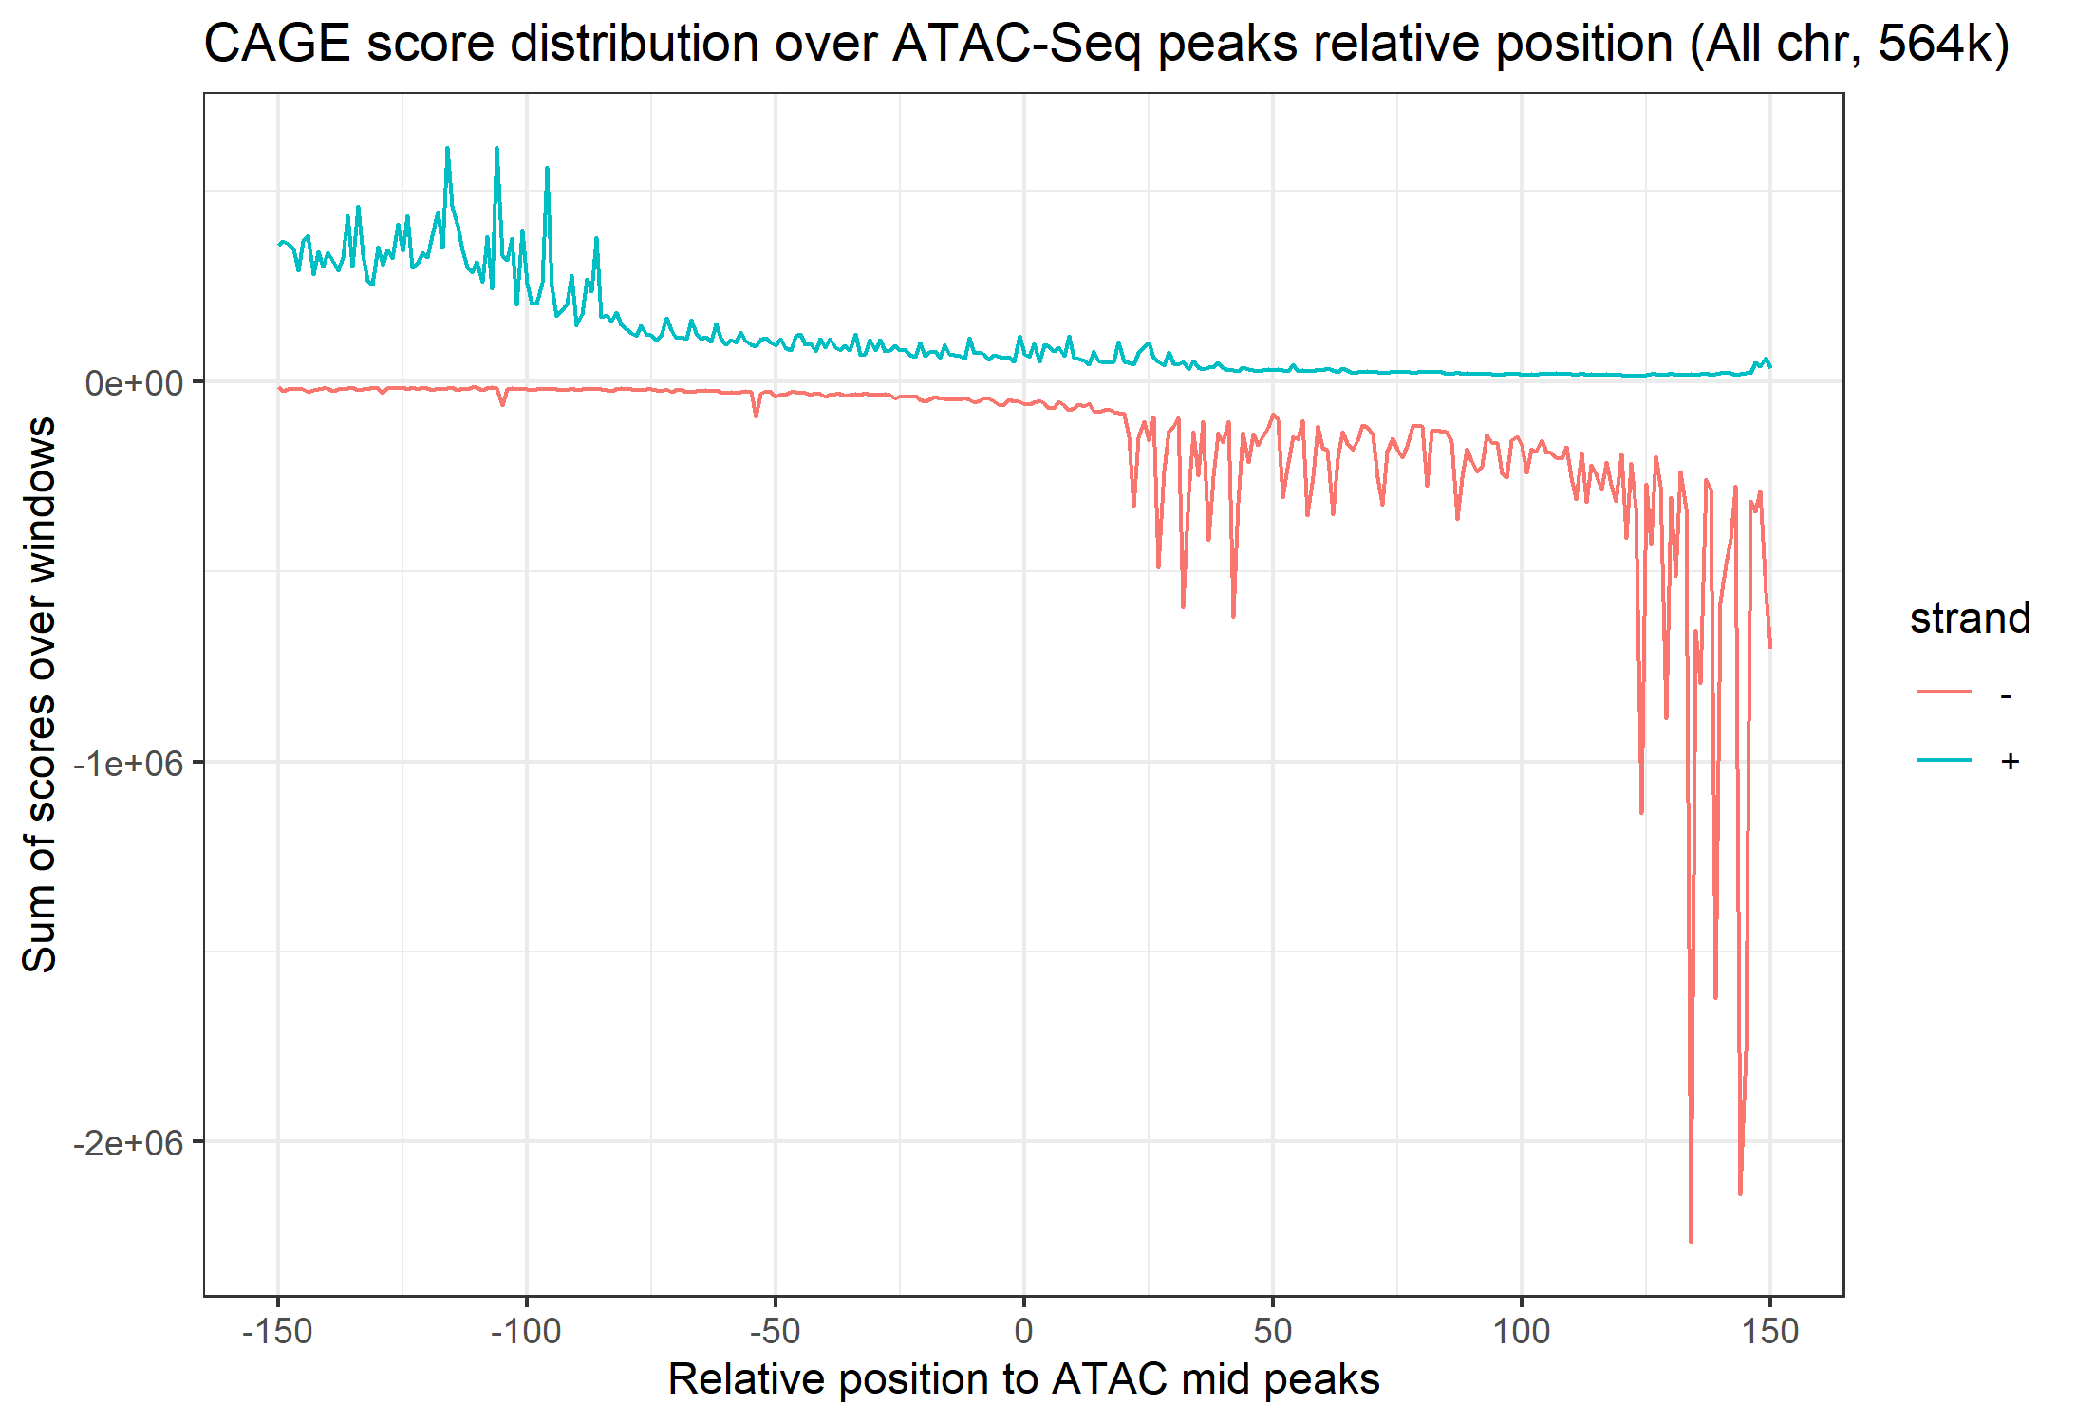
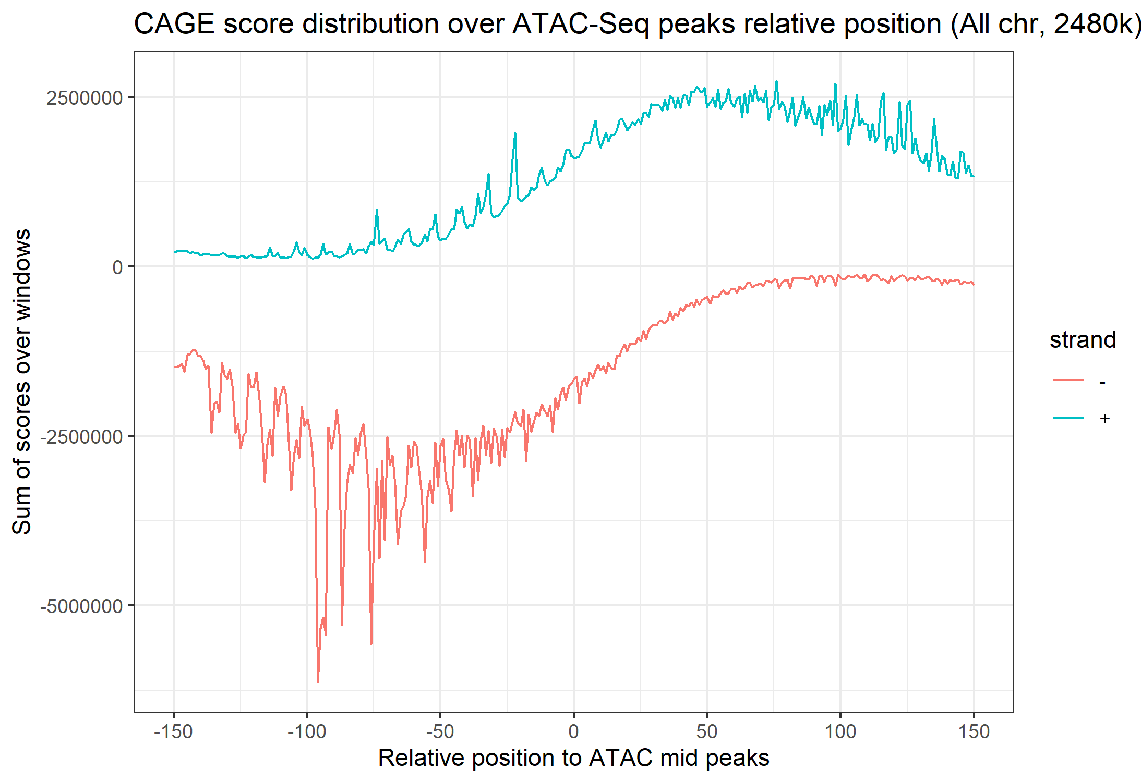
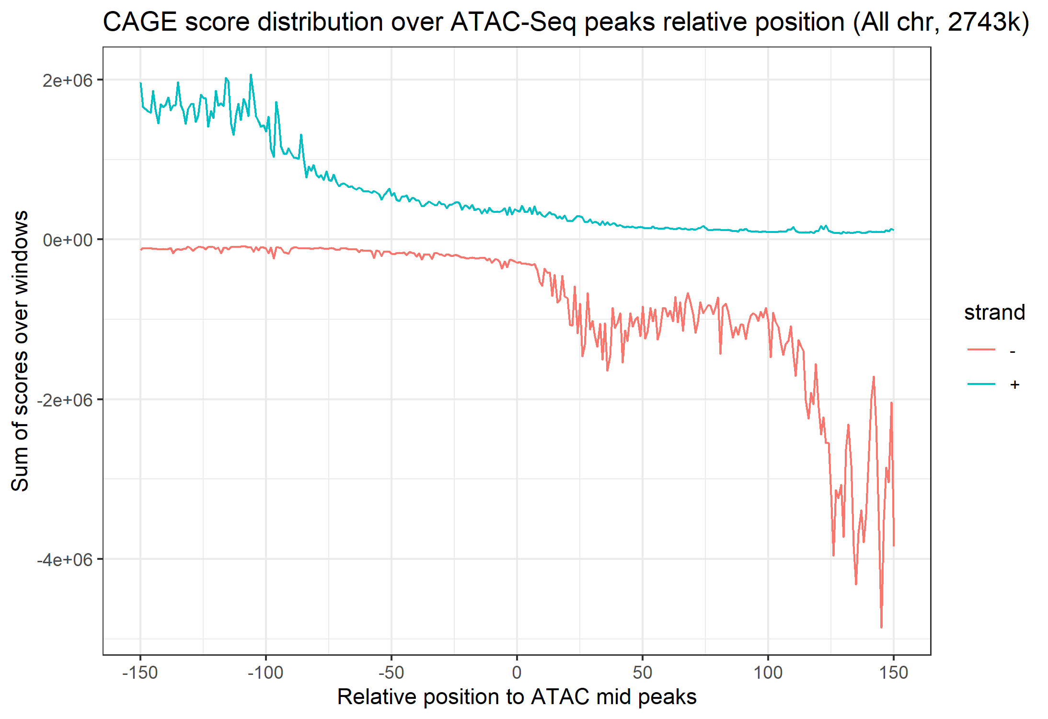
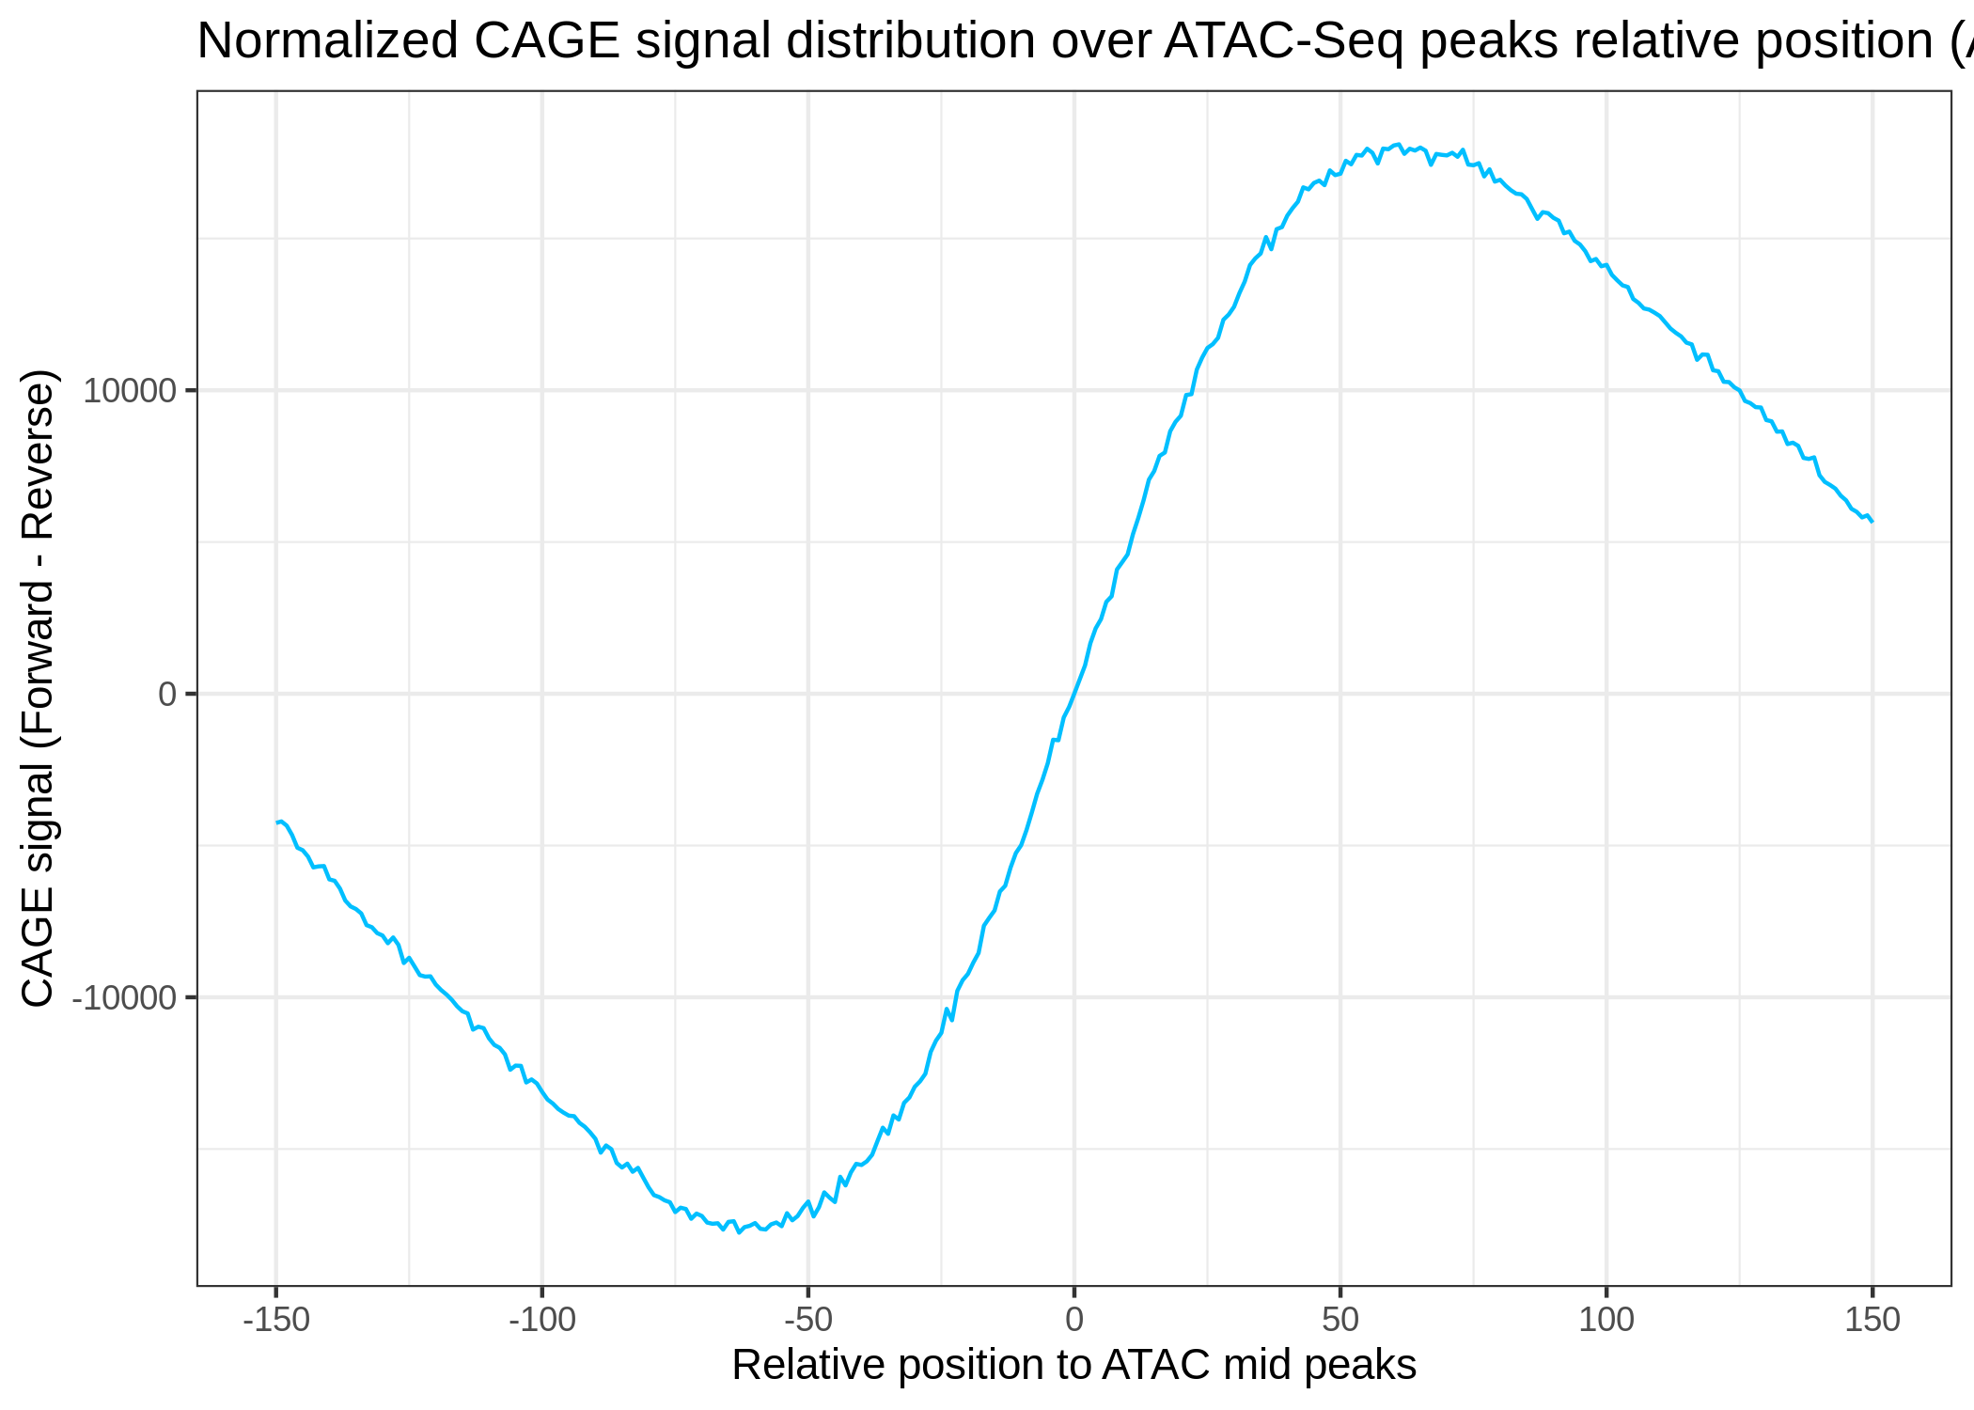
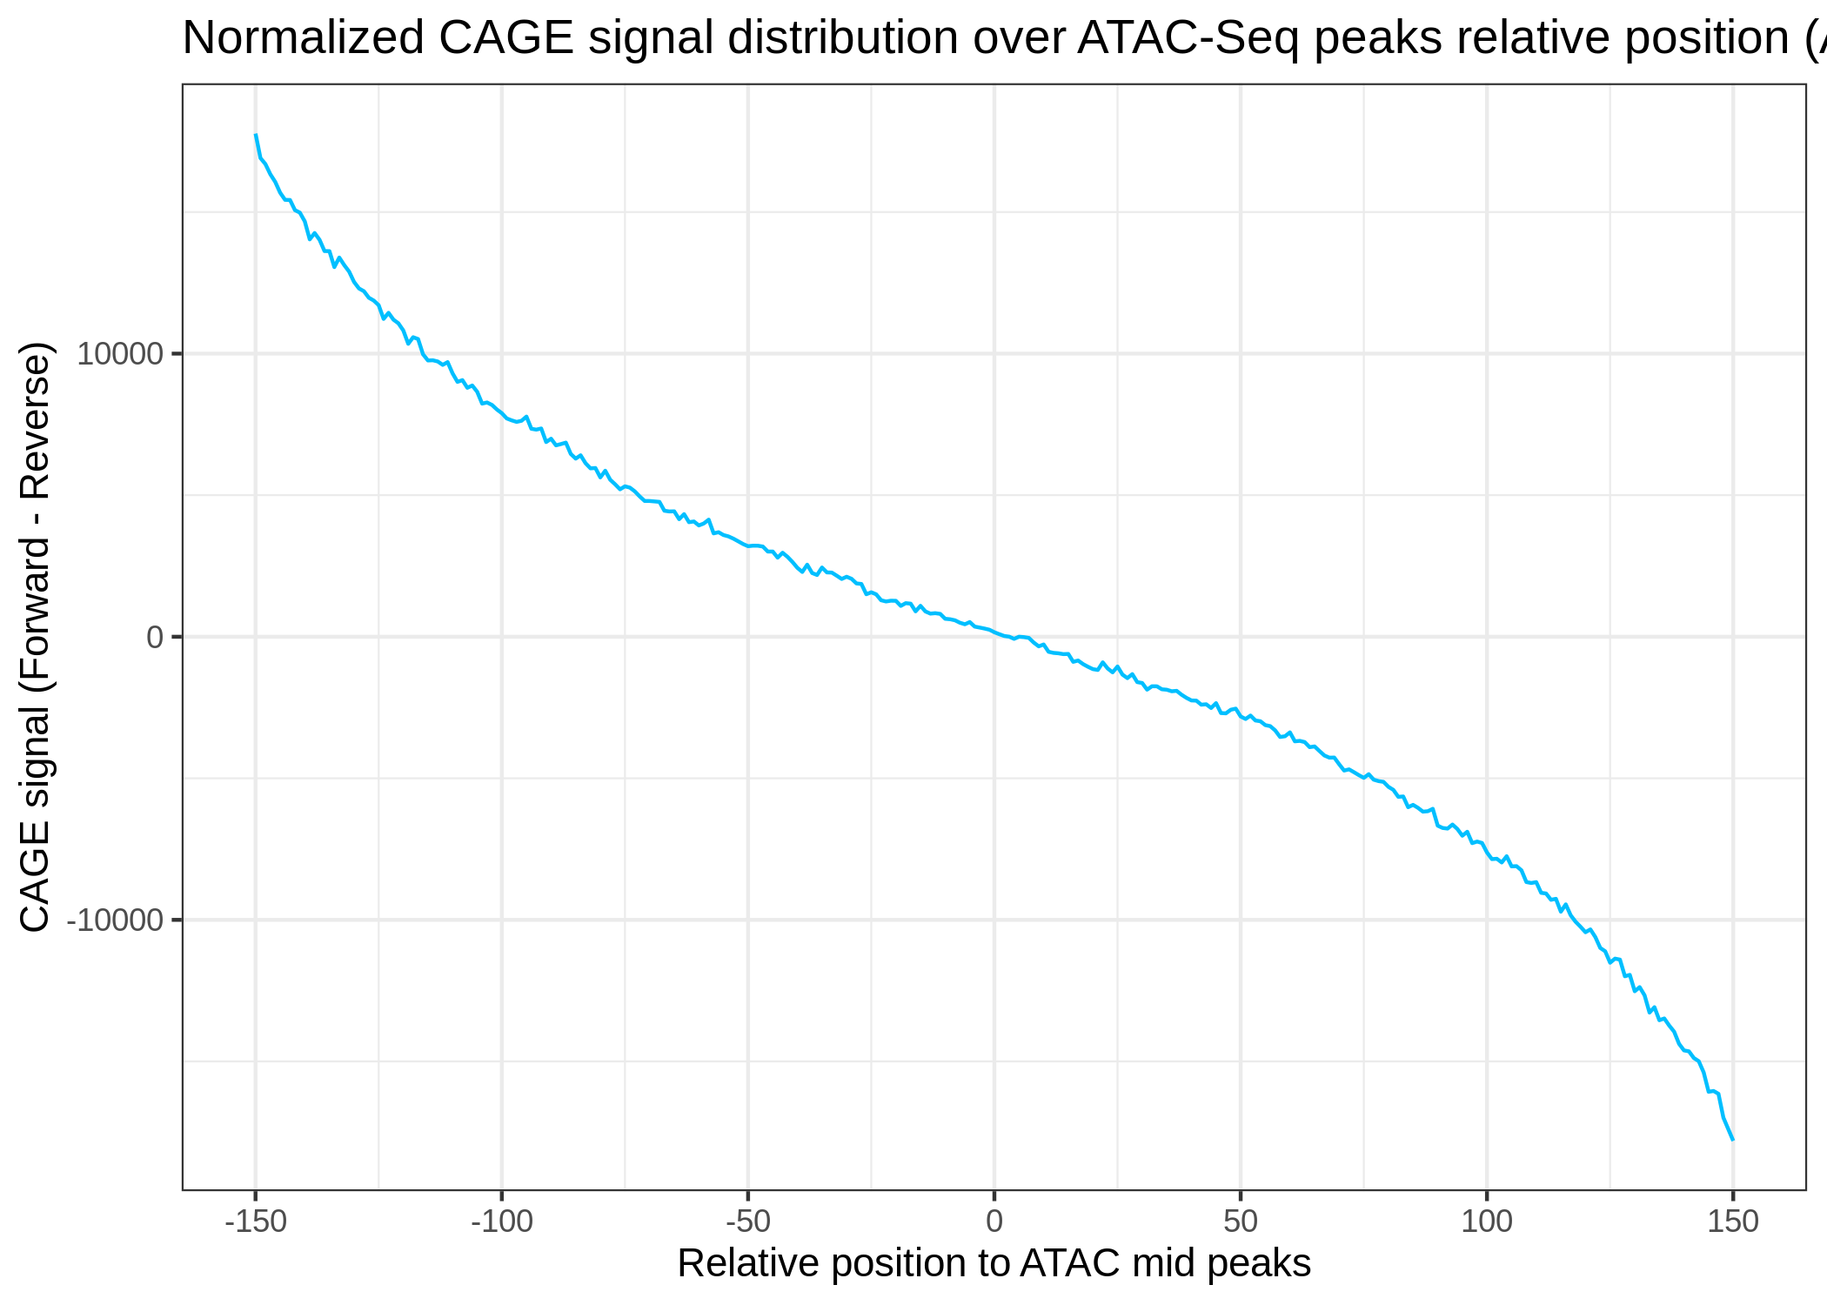
8
TP0
TP0.5
TP1
TP1.5
TP2
Profiles processing
Positive profiles
Negative profiles
All positives
All negatives
All positives processed
All negatives processed

Slide 10
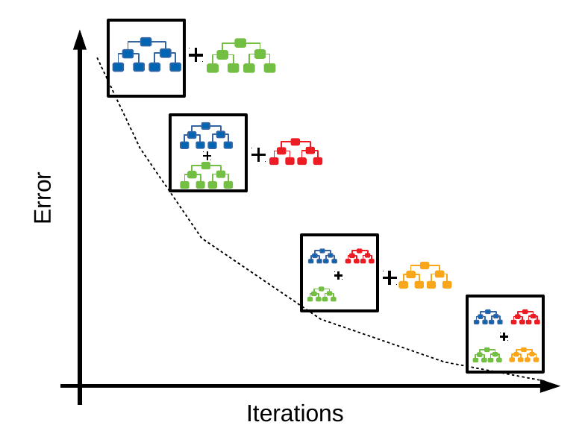
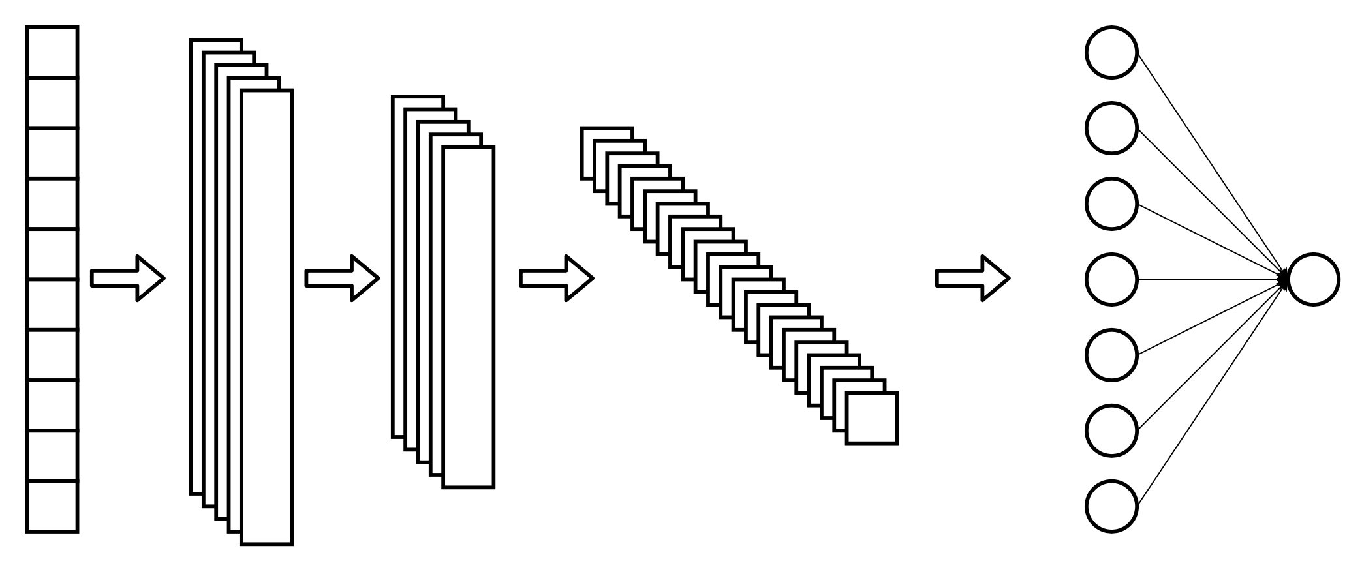
Model selection
GBDT (LGBM)
CNN
Aratrika Pal, 2020

Slide 11
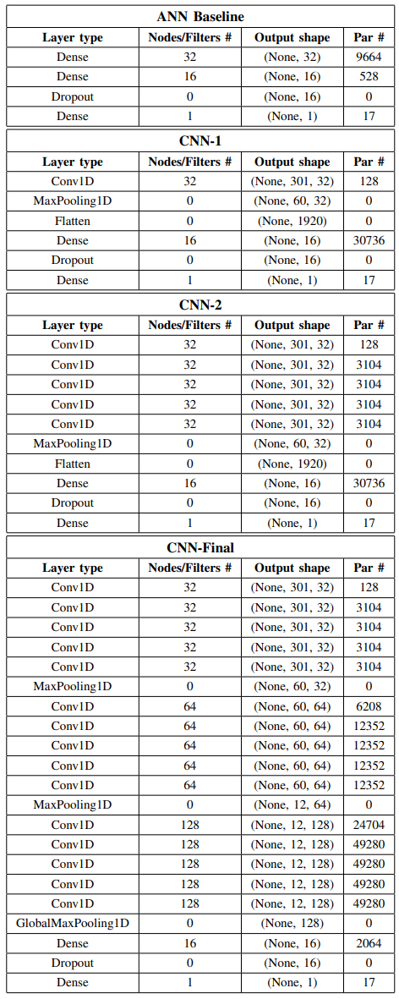
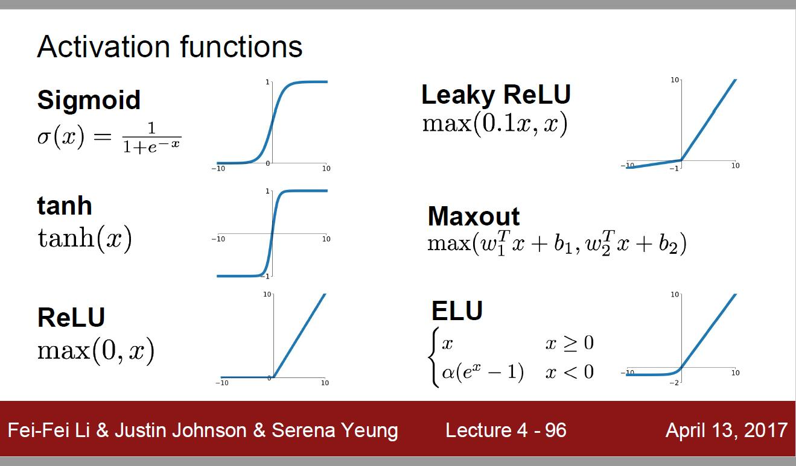
Neural network architectures
Trainable parameters 10,209
Trainable parameters 30,881
Activation functions
ReLU
Sigmoid
Trainable parameters 43,297
Trainable parameters 292,065

Slide 12
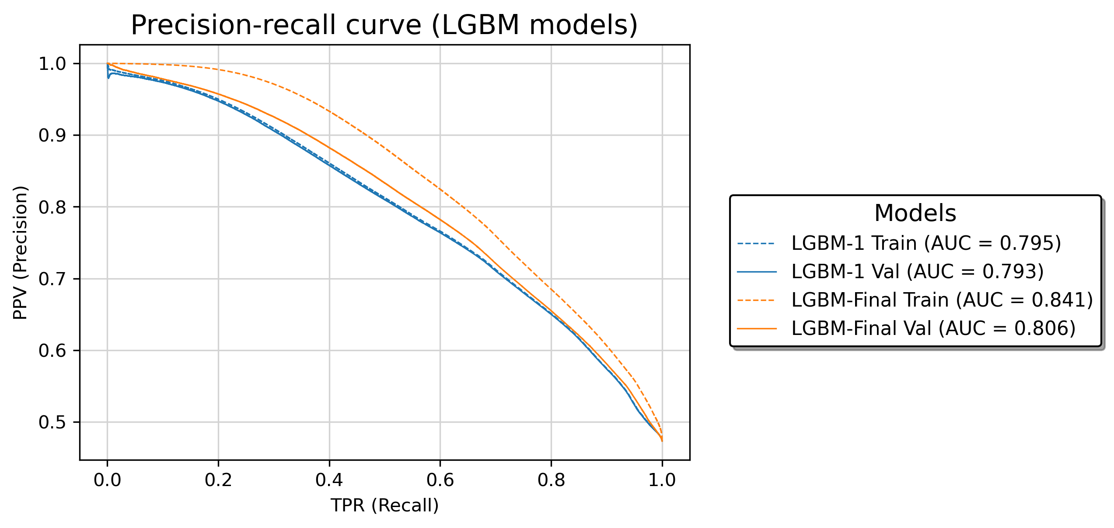
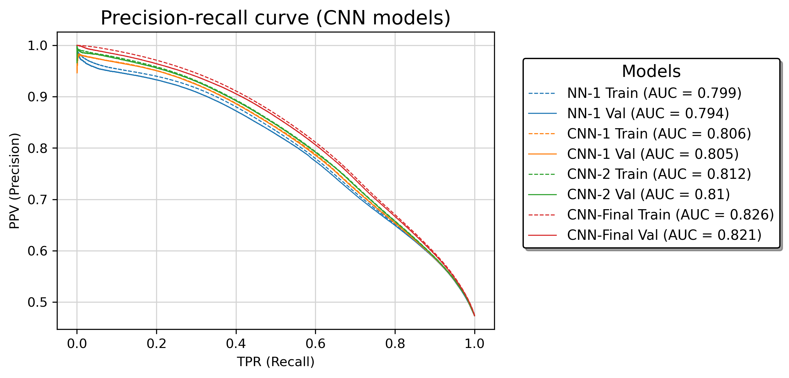
Performance evaluation for model selection
LGBM
CNN

Slide 13
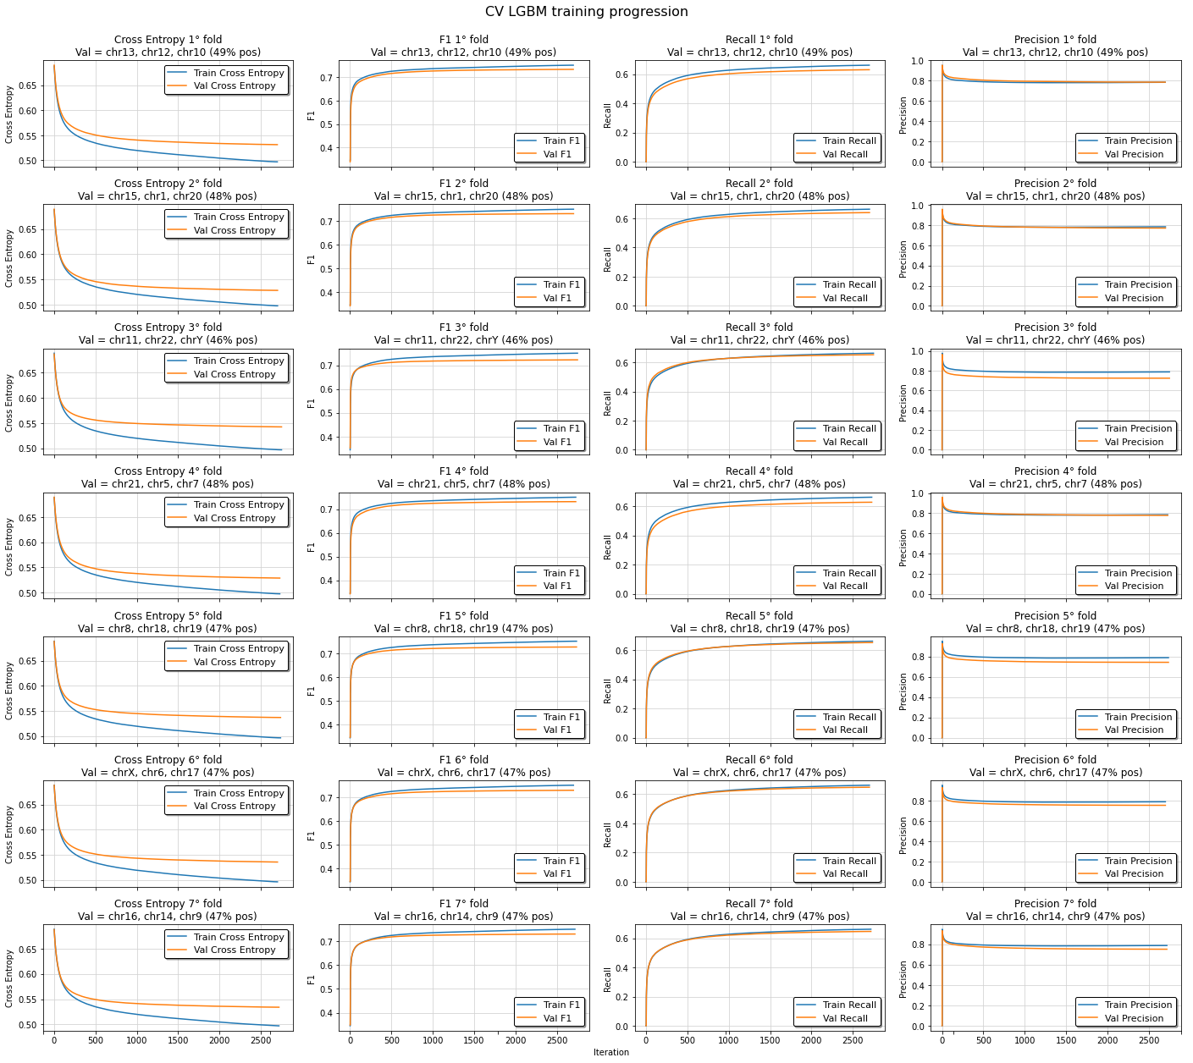
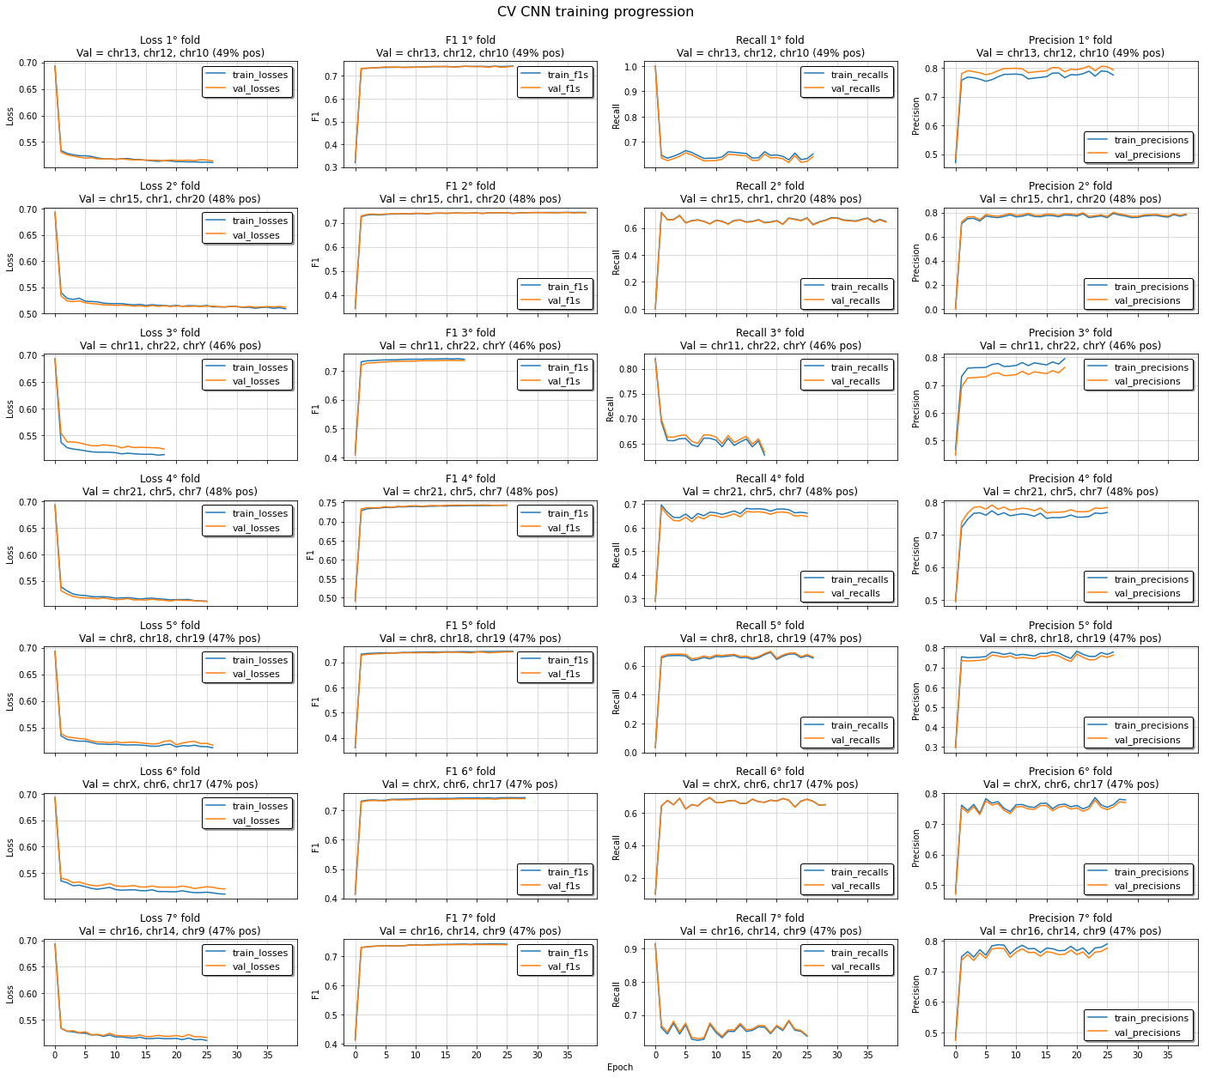
Training progression
LGBM training
CNN training

Slide 14
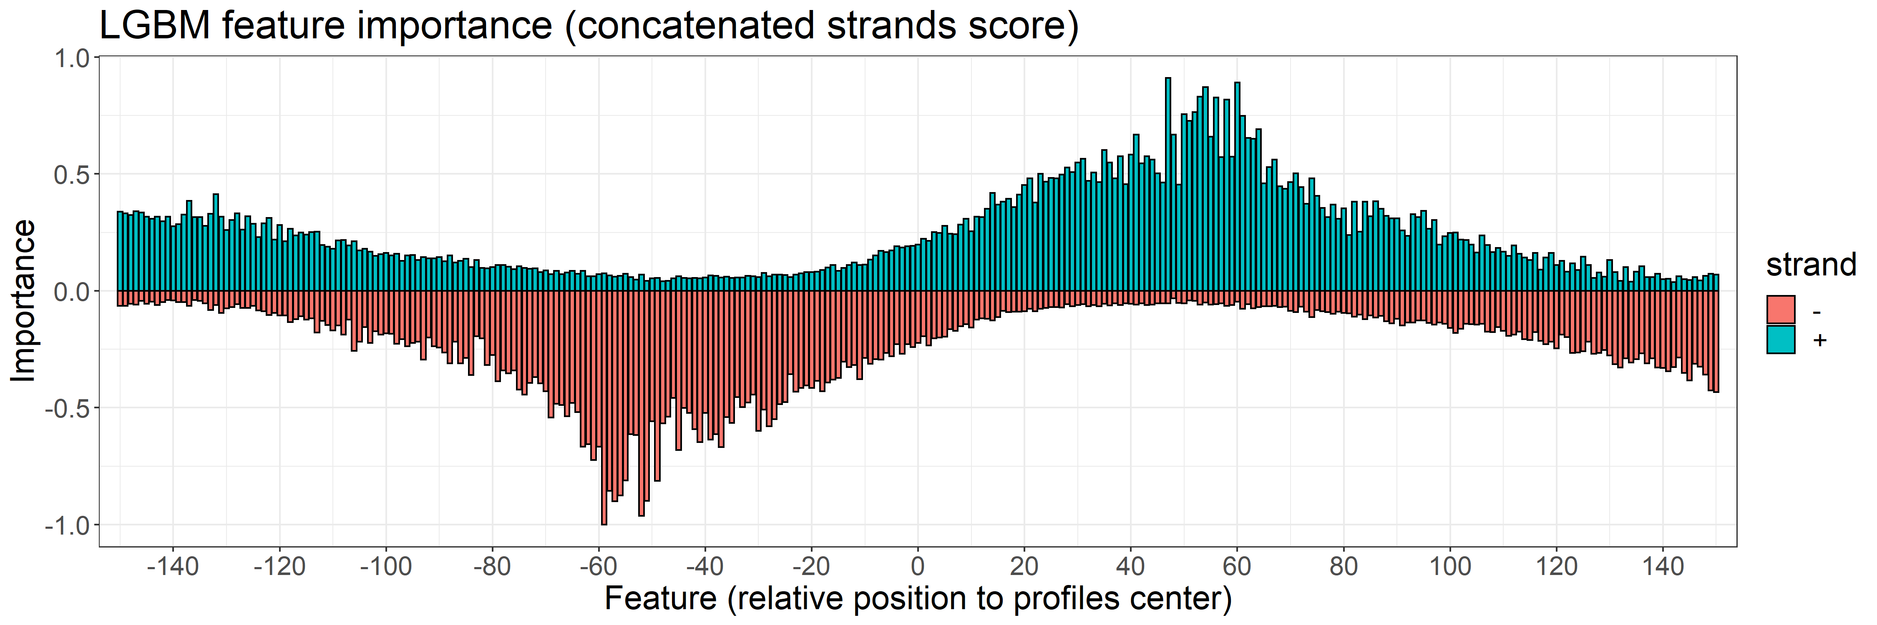
Feature importance
LGBM feature importance
Positive average profile

Slide 15
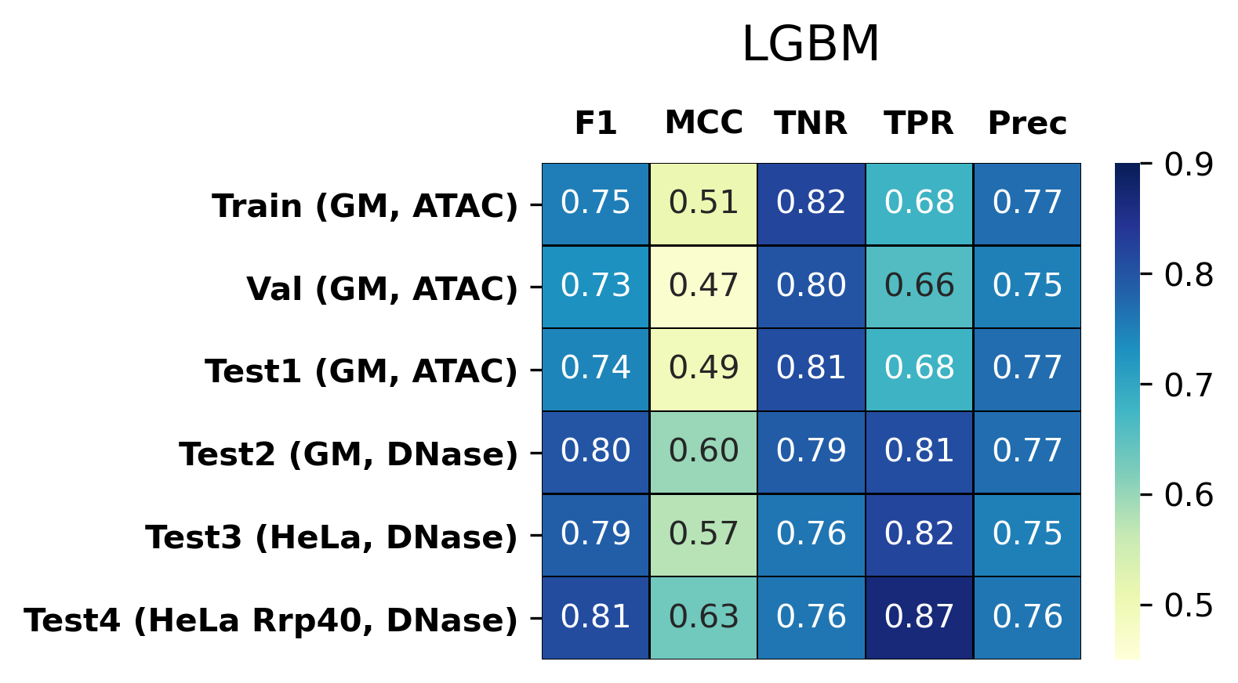
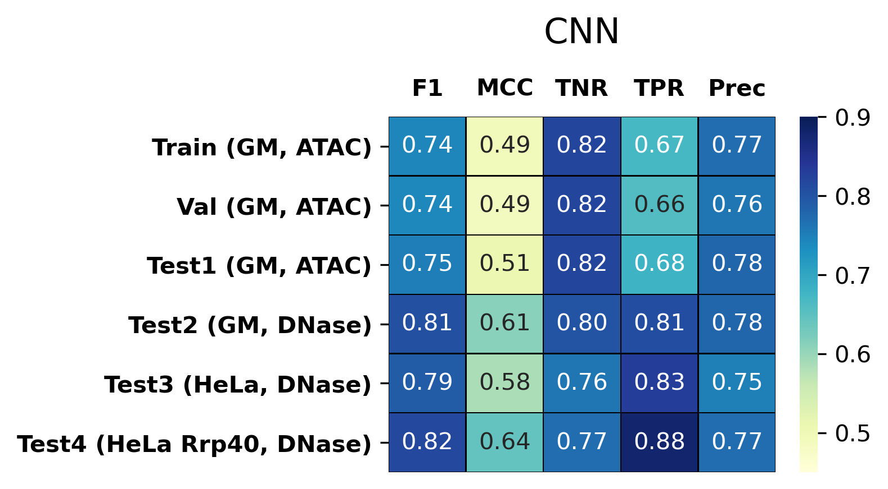
Model evaluation
LGBM
CNN

Slide 16
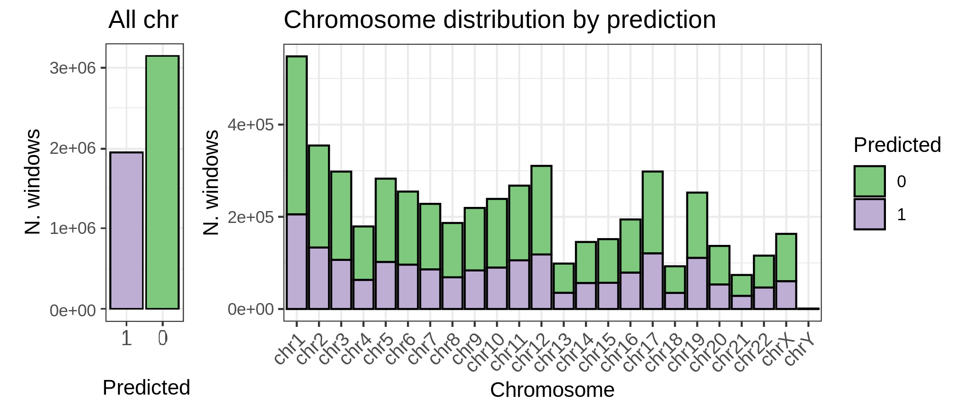
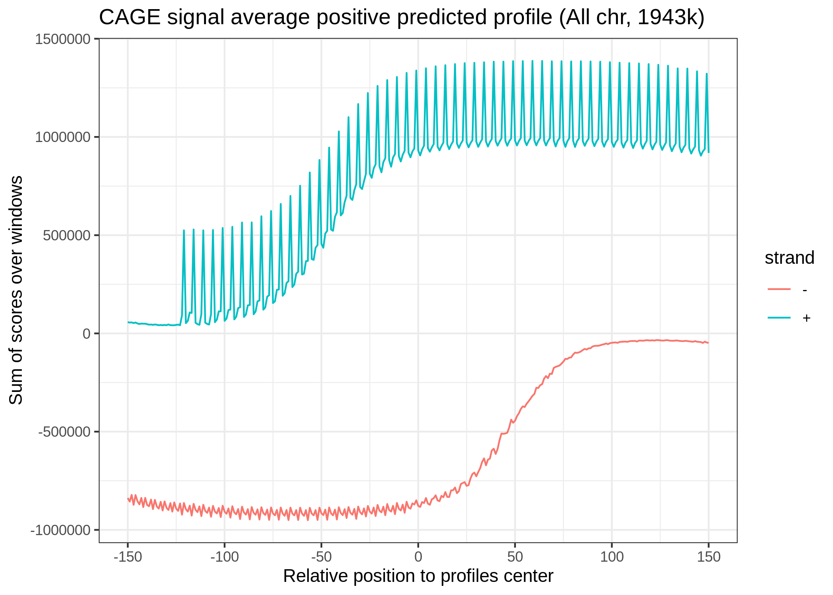
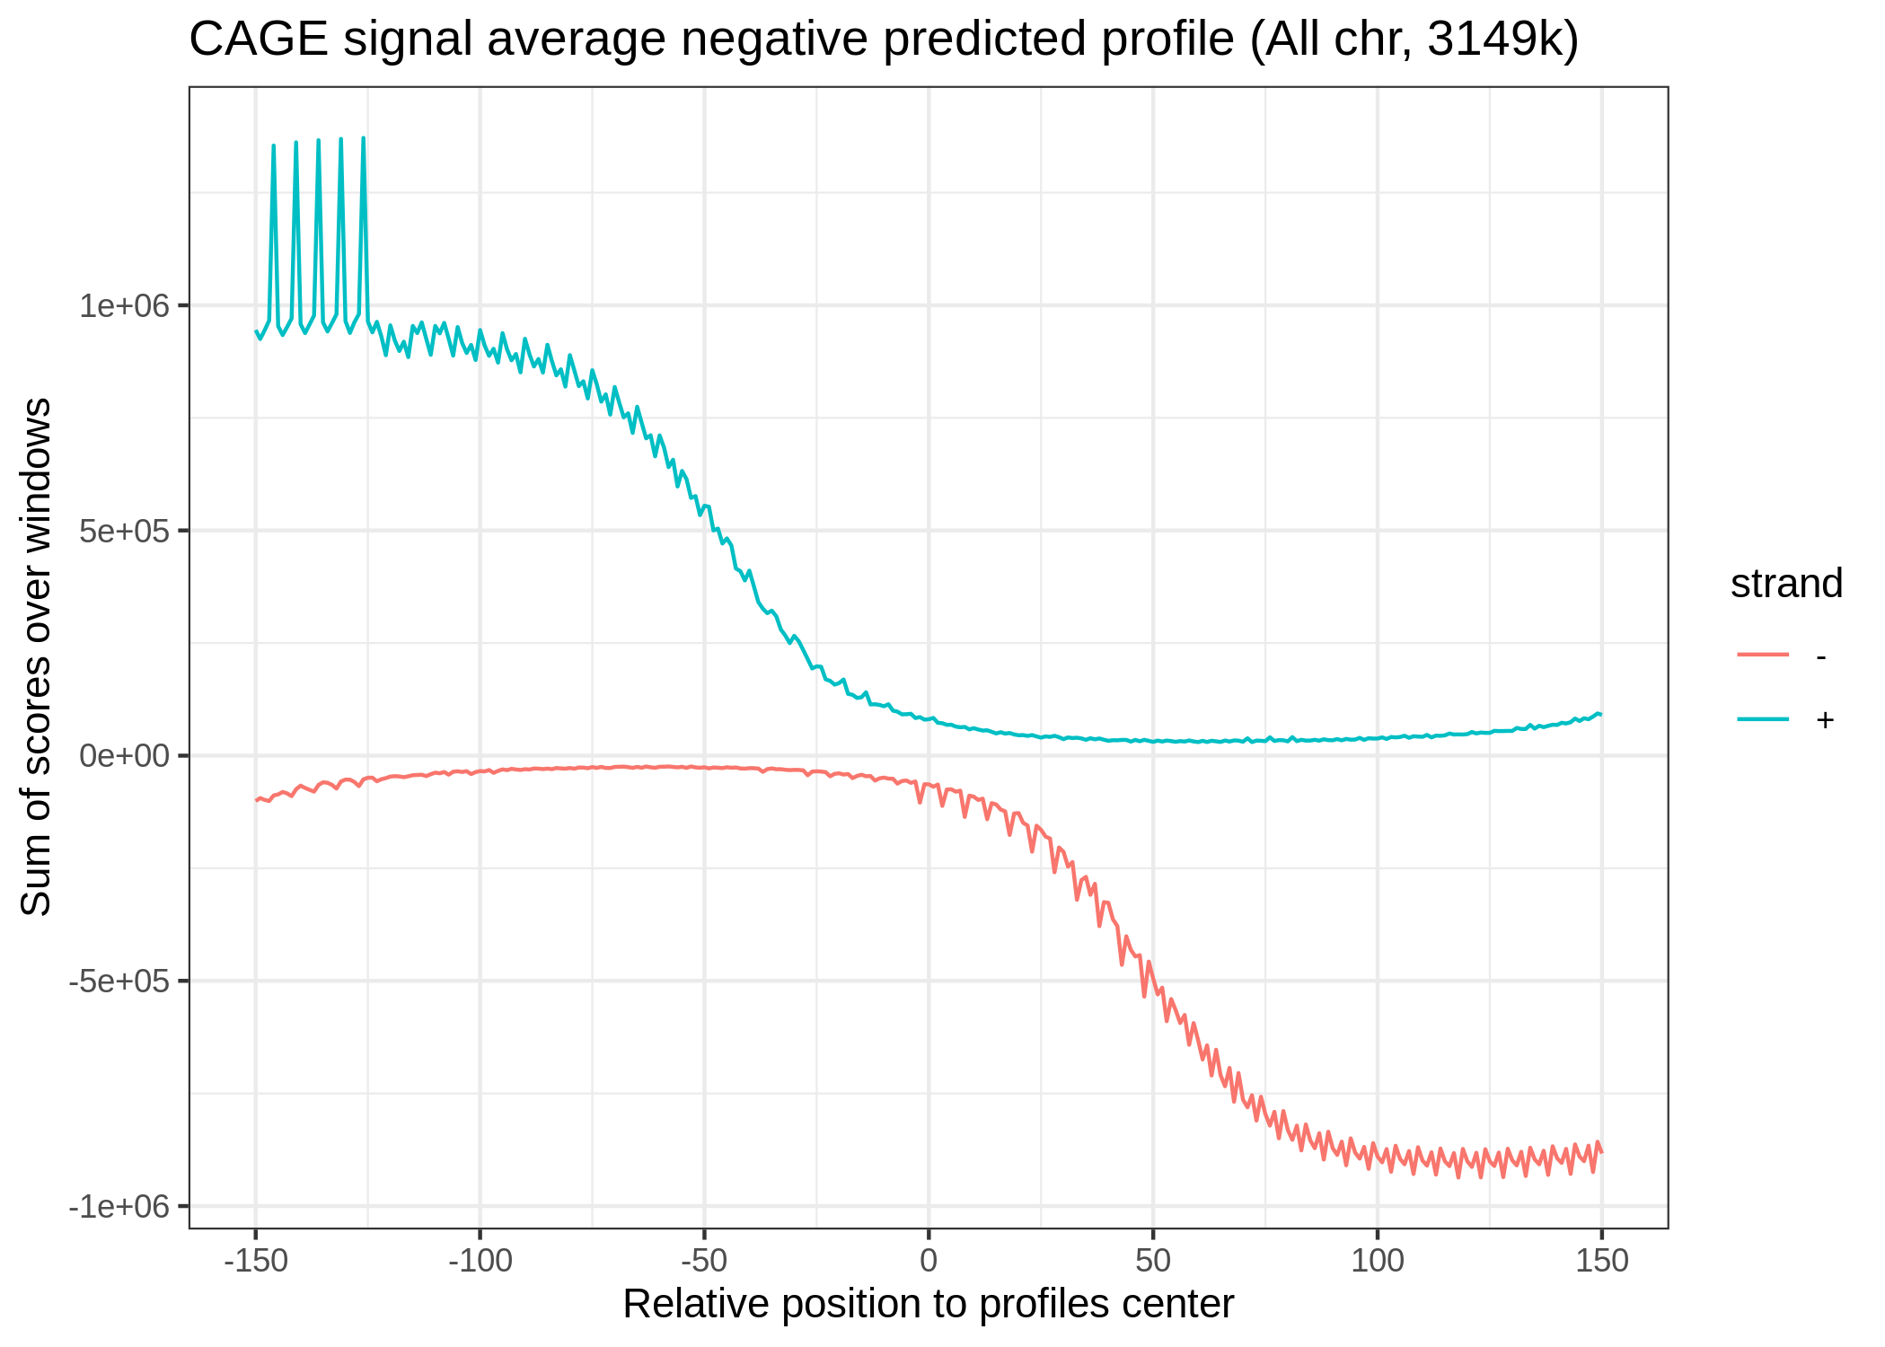
Genome-wide prediction
Classes distribution
All chromosomes (3 days):
≈ 600,000,000 total regions
≈ 20,000,000 with at least a CAGE TSS
≈ 5,100,000 with min CAGE signal
Predicted TREs: ≈ 1,940,000
38.2% of the profiles with min signal
Positive predicted profiles
Negative predicted profiles

Slide 17
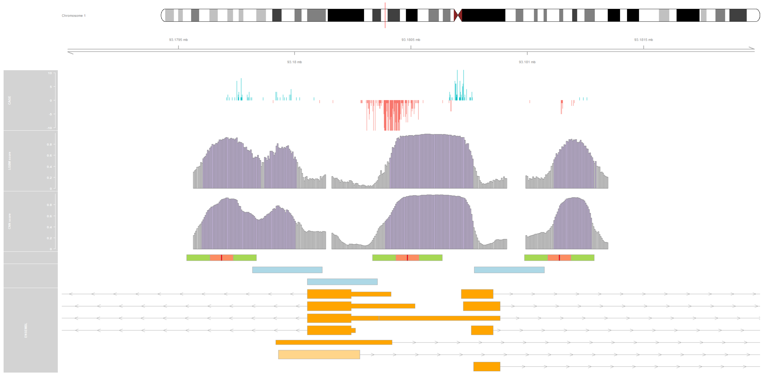
A frame from the interactive visualization
Chromosome 1
CAGE
Forward strand
Reverse strand
TREs score
LGBM
Score ≤ 0.5
Score > 0.5
TREs score
CNN
Score ≤ 0.5
Score > 0.5
OCRs
Open chromatin core
ORGs filtered
out
ENSEMBL

Slide 18
Summary
Succeeded to predict active TREs using TSS profiling and machine learning
Both LGBM and CNN obtained very good performance
The problem might not be so difficult to require complex model
The positions of the positive profiles having the highest average CAGE are the most important predictors
Promising results on nascent-RNA TSS profiling data
Input extraction can bias model evaluation
Future perspectives
Improve the evaluation strategy
Investigate the possibility of using a multiscale feature vector
Enable the tool to:
Automatically extract feature vectors to train and evaluate new models
Assign promoter and enhancer potential scores, or enhancer and promoter binary labels, to the predicted TREs
Notes:
Suggesting that the bidirectionality of the transcriptional initiation, which was used to predict TREs in previous study, is the main predictor used by the models
TSS-Seq data can be used for the prediction of TREs through machine learning
Input extraction shown that there is bidirectionality in the positive, while the majority of the negatives are in regions close to the positives
Feature importance?
CNN performed slightly better than LGBM but both performed similarly and obtained good performance
The problem might not be so difficult to model since simple NN already obtained good results and CNN training showed that it learned the patterns really fast
We have seen that by changing the data assessing chromatin accessibility, the performance changed drastically, suggesting presence of wrongly positive assigned labels in feature vectors generated with ATAC-Seq

Slide 19
Thanks for your attention

Slide 20
Supplementary slides

Slide 21
Predictive algorithms

Slide 22
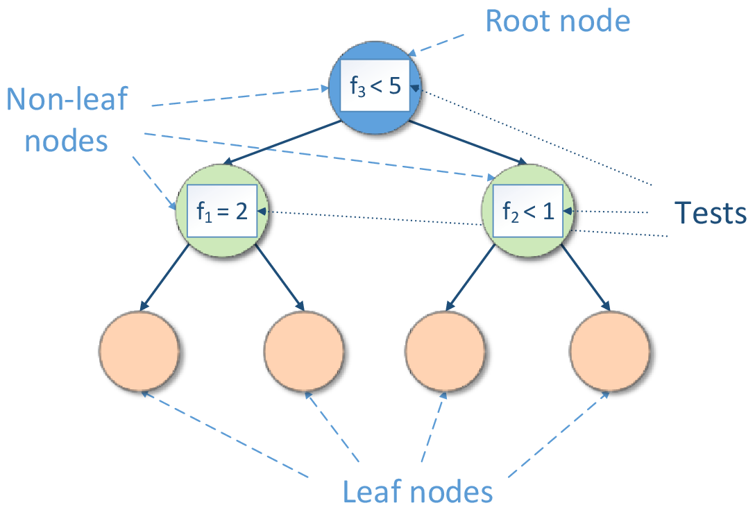
Gradient boosting based on decision trees
Decision tree
Boosting
Executable Book Project, 2020
Aratrika Pal, 2020

Slide 23

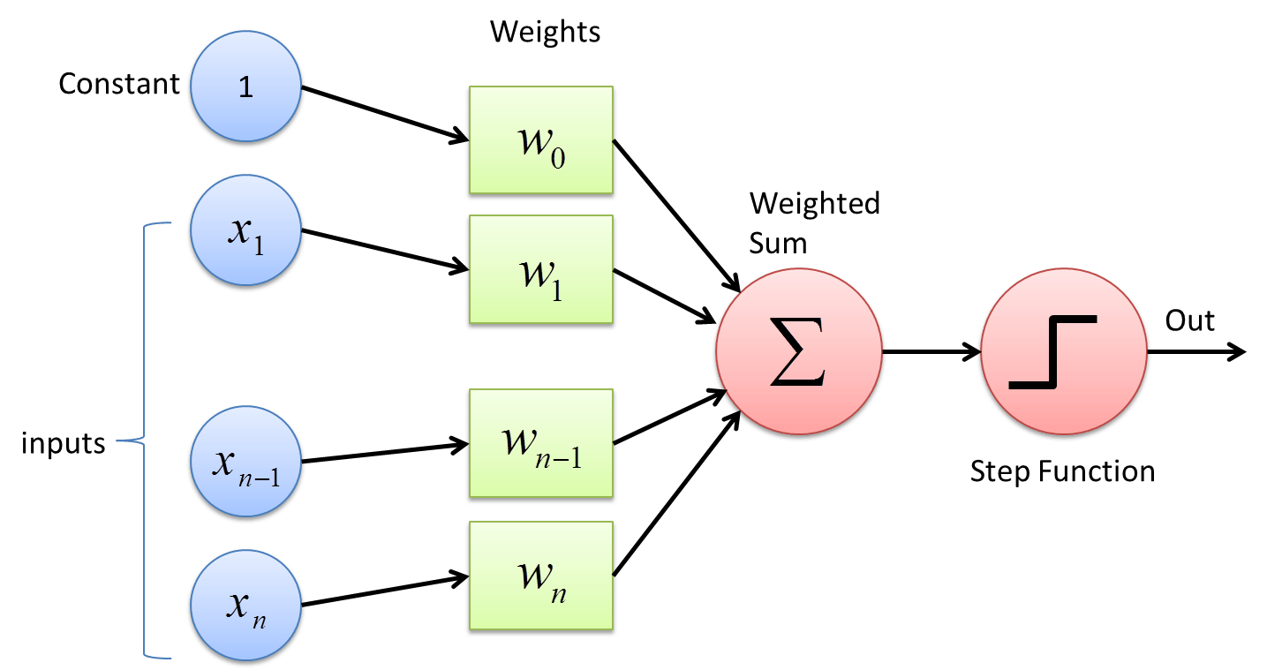
Neural network basics
Basic architecture
Artificial neuron
Output
Activation Function
Sagar Sharma, 2017
Input layer
Hidden layer 1
Hidden layer 2
Output layer
Activation functions
ReLU
Sigmoid

Slide 24
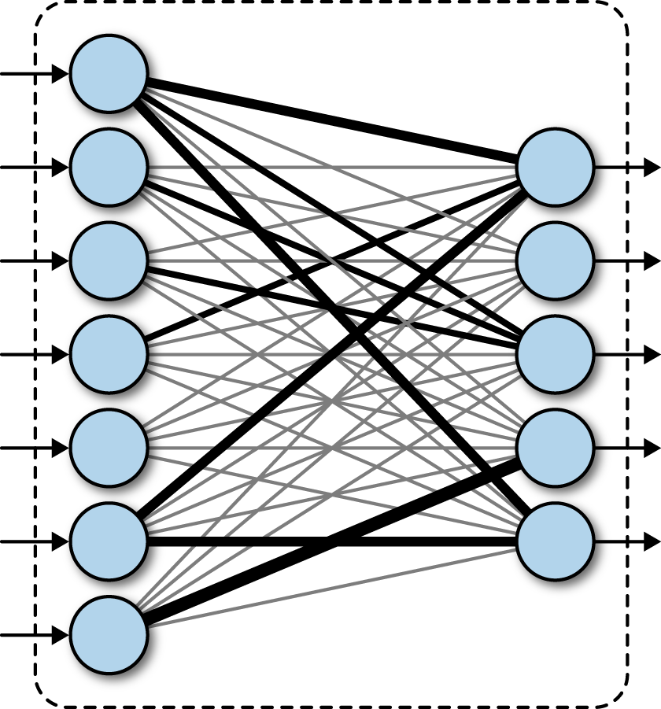
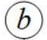
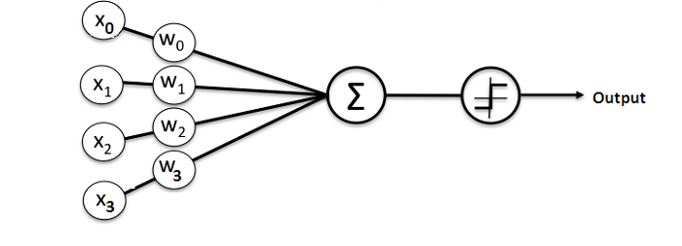
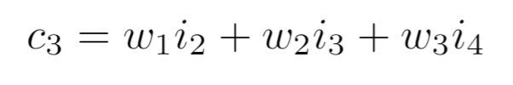
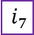
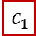

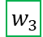
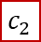
































Convolutional neural network
Convolutional layer
Max pooling layer
Dense layer
0
$${ i}_{1}$$
$${ i}_{2}$$
$${ i}_{3}$$
$${ i}_{4}$$
$${ i}_{5}$$
$${ i}_{6}$$
$${ i}_{7}$$
$${ i}_{8}$$
$${ i}_{9}$$
$${ i}_{10}$$
0
$${ i}_{1}$$
$${ i}_{2}$$
$${ i}_{3}$$
$${ i}_{4}$$
$${ i}_{5}$$
$${ i}_{6}$$
$${ i}_{7}$$
$${ i}_{8}$$
$${ i}_{9}$$
$${ i}_{10}$$
$${ w}_{1}$$
$${ w}_{2}$$
$${ w}_{3}$$
$${ w}_{1}$$
$${ w}_{2}$$
$${ w}_{3}$$
$${ w}_{1}$$
$${ w}_{2}$$
$${ w}_{3}$$
$${ c}_{1}$$
$${ c}_{2}$$
$${ w}_{1}$$
$${ w}_{2}$$
$${ w}_{3}$$
……………
$${ w}_{1}$$
$${ w}_{2}$$
$${ w}_{3}$$
Bharath Ramsundar, et al, 2018
$${ c}_{1}$$
$${ c}_{2}$$
$${ c}_{3}$$
$${ c}_{4}$$
$${ c}_{5}$$
$${ c}_{6}$$
$${ c}_{7}$$
$${ c}_{8}$$
$${ c}_{9}$$
$${ c}_{10}$$
Michael J. Garbade, 2018

Slide 25

Cross-entropy loss function

Slide 26
301
Input vector
(bs, 301)
…
CNN-Final architecture
3
32
32 x Kernels (size 3, stride 1, zero-padding)
w
w
w
Conv layer x5
(bs, 301, 32)
301
…
32
…
Output 32 x Feature maps
…
Max pooling layer
(bs, 60, 32)
…
32
…
Pooling size 5, stride 5
…
60
Conv layer x5
(bs, 60, 64)
…
64
…
64 x Kernels (size 3, stride 1, zero-padding)
…
…
……
60
Max pooling layer
(bs, 12, 128)
Pooling size 5, stride 5
12
…
…
128
…
128 x Conv Filters (size 3, stride 1, zero-padding)
Conv layer x5
(bs, 24, 128)
…
…
Global max pooling (bs, 128)
128
Dense / dropout
(bs, 16)
…
Dropout
(rate 0.5)
Output layer
(bs, 1)

Slide 27
Results supplementary

Slide 28






A
C
B
D
E

Slide 29


Accuracy measures
Model evaluation
ROC

Slide 30






Predicted profiles (HeLa)
Positive profiles (ground truth)
Predictions
TN
FP
Negative profiles (ground truth)
FN
TP

Slide 31


A
Predicted probabilities (HeLa)
B
TN
FP
FN
TP

Slide 32

One frame of the interactive visualization
Chromosome 1
CAGE
Forward strand
Reverse strand
TREs score
LGBM
Score ≤ 0.5
Score > 0.5
TREs score
CNN
Score ≤ 0.5
Score > 0.5
DHS summits
Open chromatin core
ENSEMBL

Slide 33

Feature importance
Concatenated profiles
Processed profiles

Slide 34
Input extraction supplementary

Slide 35


Exploratory plots
Classes distribution
Total CTSS distribution

Slide 36








Positive profiles
R1
R2
R3
R4
Positives merged
Negative profiles
R1
R2
R3
R4
Negatives merged

Slide 37






Input extraction summary
Total 3kk (33% positive)
Total 6.2kk (47% positive)
Halved features
Positive profiles
Data augmentation
Profiles processing
Negative profiles

Slide 38




Example of profiles
Positive profiles
Negative profiles

Slide 39


Profiles length
Positive profile 301 bp
Positive profile 601 bp

Slide 40
Replicate 1
101 bp
ATAC+ central core
Positive profiles
301 bp
Positive
Negative profiles
301 bp
Negative (selected randomly)
Negative (selected randomly)

Slide 41
Replicate 1 augmented
101 bp
ATAC+ central core
Positive profiles
301 bp
Positive shifted (-10)
Positive
Positive shifted (+10)
Negative profiles
301 bp
Negative (selected randomly)
Negative (selected randomly)
Negative flanking shifted (-10)
Negative flanking shifted (+10)
Negative flanking shifted (-20)
Negative flanking shifted (+20)
Negative flanking shifted (-30)
Negative flanking shifted (+30)

Slide 42

Replicate 1
ATAC removed
ATAC retained
CAGE
Profiles +
Profiles -

Slide 43

Replicate 1 augmented (before filtering)
ATAC removed
ATAC retained
CAGE
Profiles +
Augmented +
Profiles -
Augmented -

Slide 44

Replicate 1 augmented (after filtering)
ATAC removed
ATAC retained
CAGE
Profiles +
Augmented +
Profiles -
Augmented -

Slide 45
Introduction supplementary

Slide 46


CAGE
ATAC-Seq and DNase-Seq
Robin Andersson and Albin Sandelin, 2020
Chatterjee, Sumantra, and Nadav Ahituv, 2017

Slide 47
Activating TREs
Robin Andersson and Albin Sandelin, 2020

Slide 48

Transcriptional regulatory elements (TREs)
Lehnard, et al, 2012

